Slide 1
Stock Assessment for Petrale Sole – Introduction and Data
This is the Teal Title Slide, you can swap to the Blue 1 Title Slide or Blue2 Title Slide in the Layout menu
Ian Taylor, Vlada Gertseva and Nick Tolimieri
24-28 July 2023
These materials do not constitute a formal publication and are for information only. They are in a pre-review, pre-decisional state and should not be formally cited or reproduced. They are to be considered provisional and do not represent any determination or policy of NOAA or the Department of Commerce

Slide 2
Outline
Background
Data
Landings
Discards
Fishery length and age compositions
Fishery-independent data
Biological parameters
Model
Bridging analysis
Model Results
Diagnostics
Concluding remarks

Slide 3
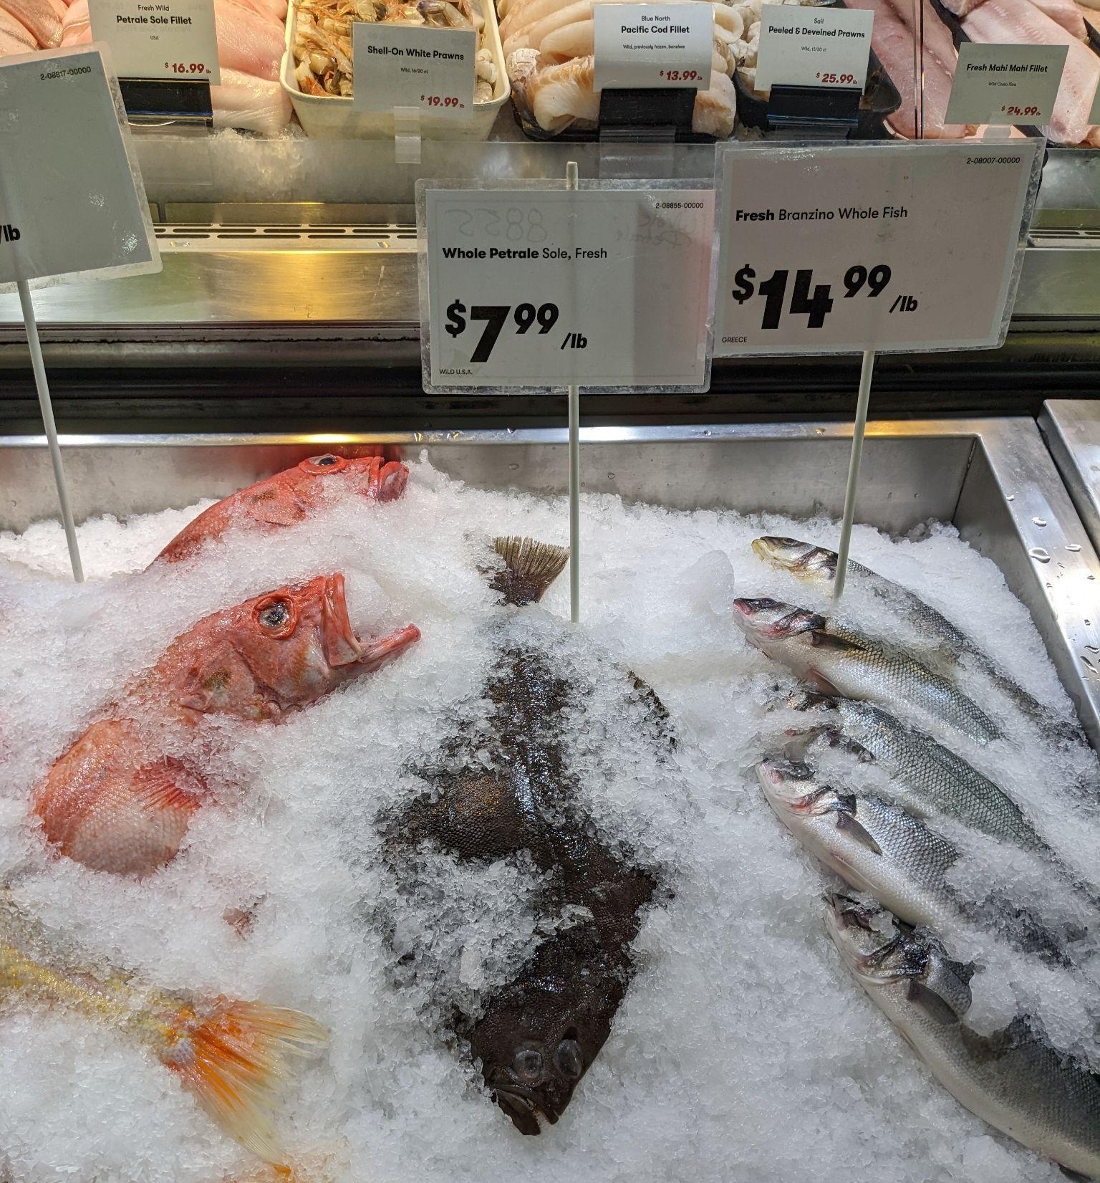
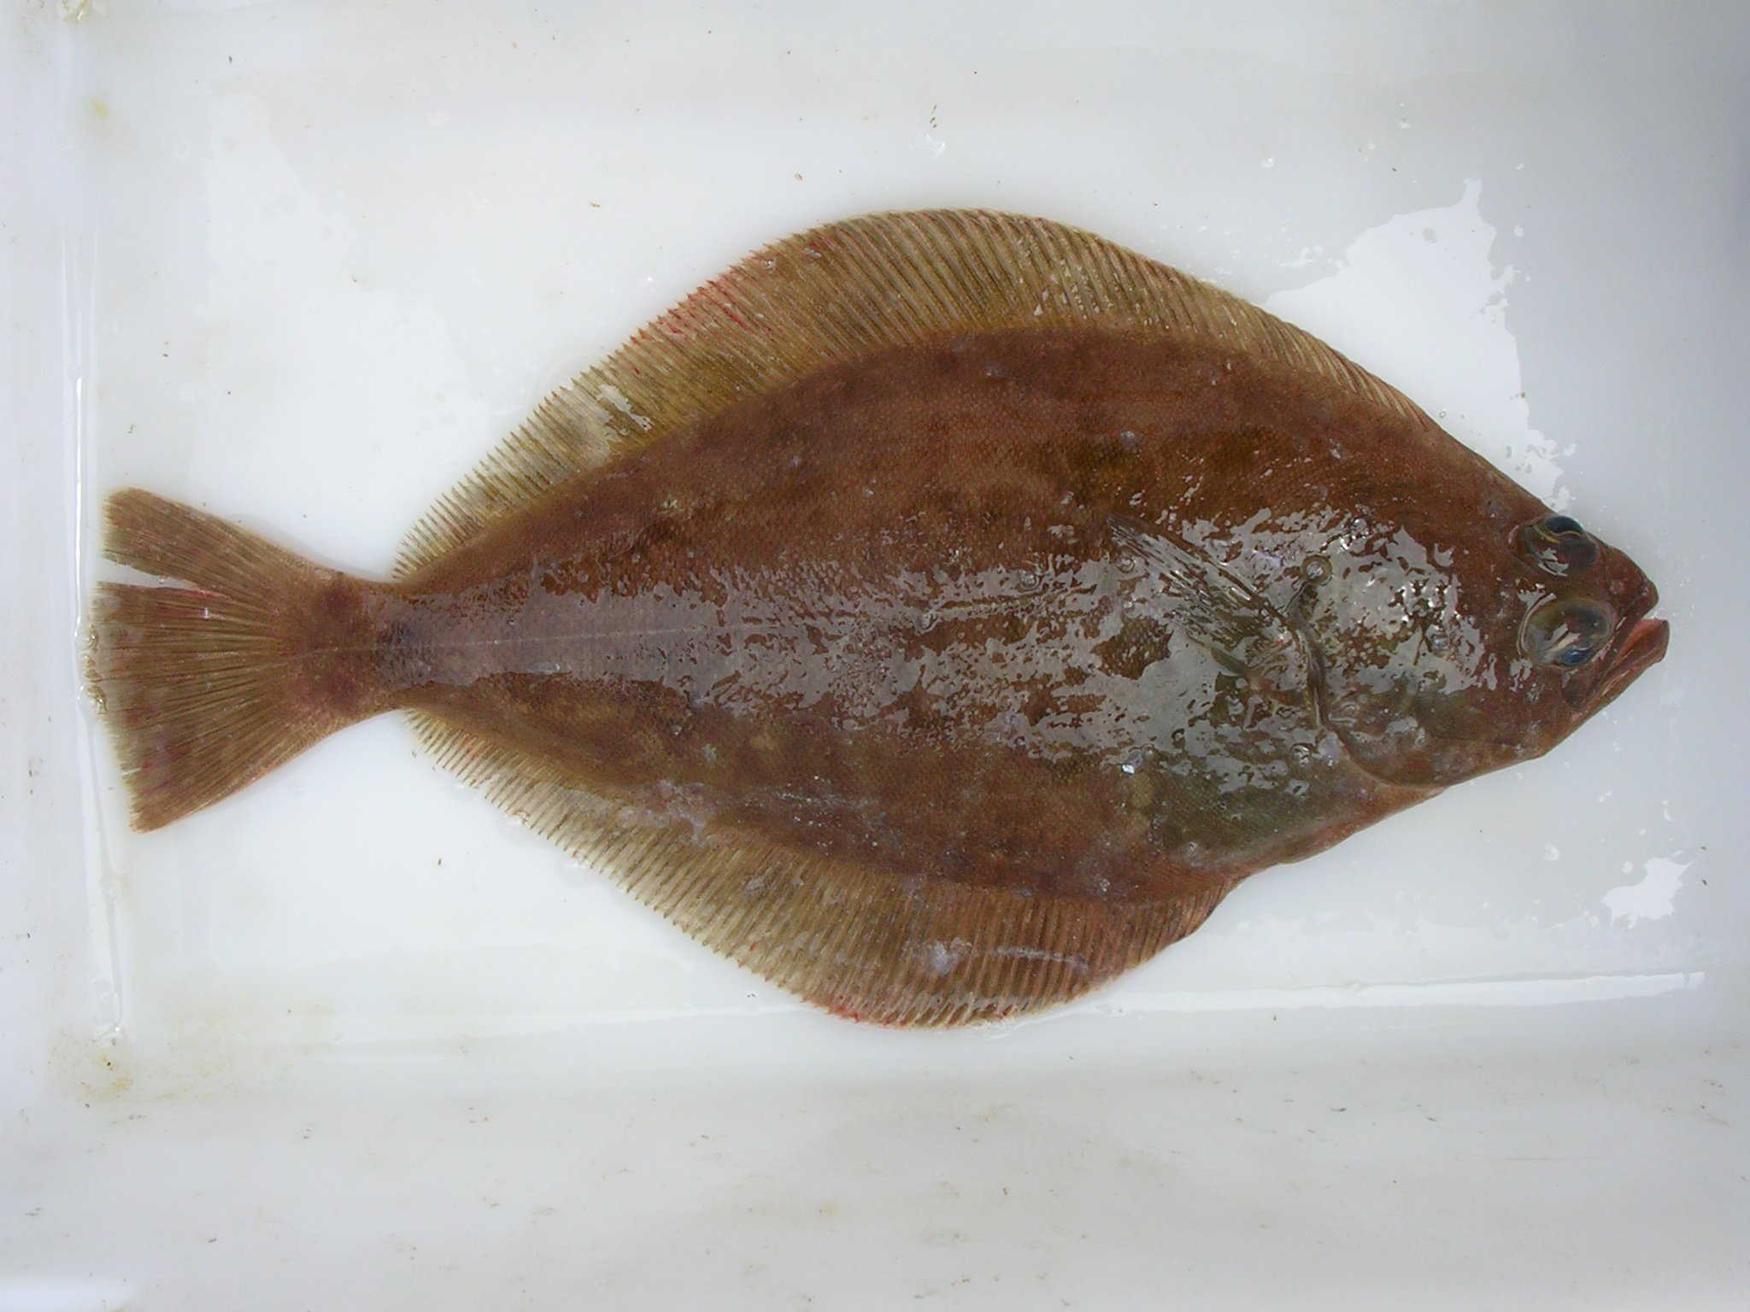
Background
Photo: anonymous NWFSC staff on WCGBT Survey
Photo: Ian Taylor at Town & Country Market Shoreline

Slide 4
Biology and life history
Medium-sized (around 60 cm), moderately long-lived (around 30 years)
Distributed from Gulf of Alaska to Baja California
No indication of multiple stocks
Depths range 0–550 m
Prefer soft bottoms
Exhibit ontogenetic movements (move to deeper waters as they age)
Adults migrate seasonally (offshore for spawning in winter and back inshore in spring)

Slide 5
Assessment area
West Coast of the United States (waters off CA, OR and WA).
Most valuable flatfish species targeted.
Taken by bottom trawl gear (landings by other gears are negligible).
Discard is small.

Slide 6
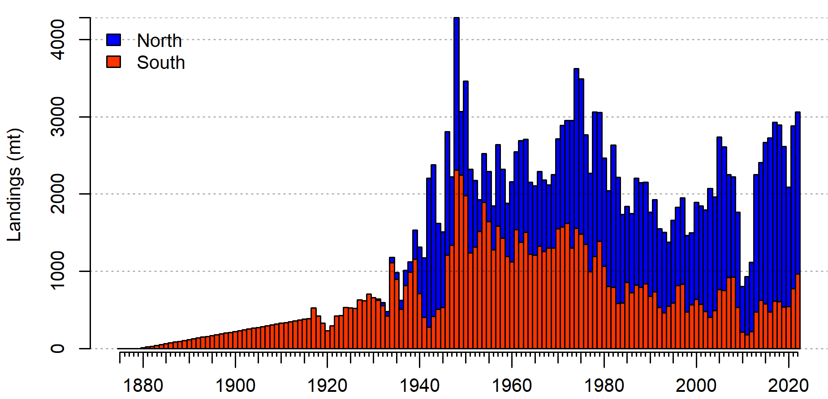
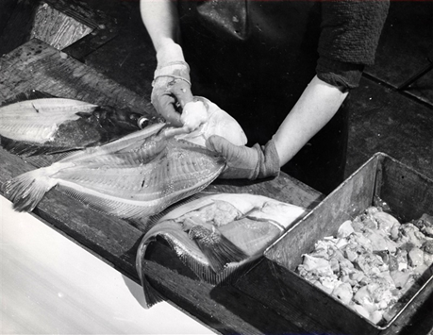
Background – fishery removals
Fishery started in California in the late 1800s;
Extended north, to Oregon and Washington starting in the 1930s, with progress of trawl gear technology;
Catches inreased in the 1940s, due to increased demands during WWII and vitamin A fishery;
Catches increased again in the 1950s and 1960s, when winter spawning aggregations were discovered and winter fisery developed.
Declared overfished in 2009, and rebuilt in 2015.
Photo credit: NOAA Central Library Historical Fisheries

Slide 7
Background: assessment history
Stock was assessed multiple times.
Comparison of estimated time series of summary biomass is on the right.
Declared overfished in 2009.
Declared rebuilt in 2015 (reference points also changed).
Last full assessment in 2013.
Last update assessment in 2019.
Full assessment in 2023 is the first since 2013

Slide 8
Base model specifications
Stock synthesis version 3.30.21 (released February 2023)
Modeling period begins in 1876, unfished equilibrium prior to that.
One area, two fleets (North and South)
Two-sex model
Mortality and growth fully estimated for each sex separately.
Steepness fixed at 0.8 (Myer’s prior from meta-analysis).
Asymptotic selectivity, sex specific.
Blocks on selectivity and retention, to allow temporal variation n parameters.

Slide 9
2019 assessment
2023 assessment
North and South fleets were further divided into Summer and Winter fisheries.
Winter fisheries CPUEs included.
Triennial survey divided into two time series.
M and growth estimated.
Recruitment and h estimated.
Sex-specific selelctivity.
Retrained separate fleets for North and South
Seasonal fisheries combined into annual calendar year removals.
Winter fisheries CPUEs removed.
Triennial survey included as one time series.
M and growth estimated.
Recruitment estimated and h fixed.
Retained sex-specific selectivity, additional blocks included.

Slide 10
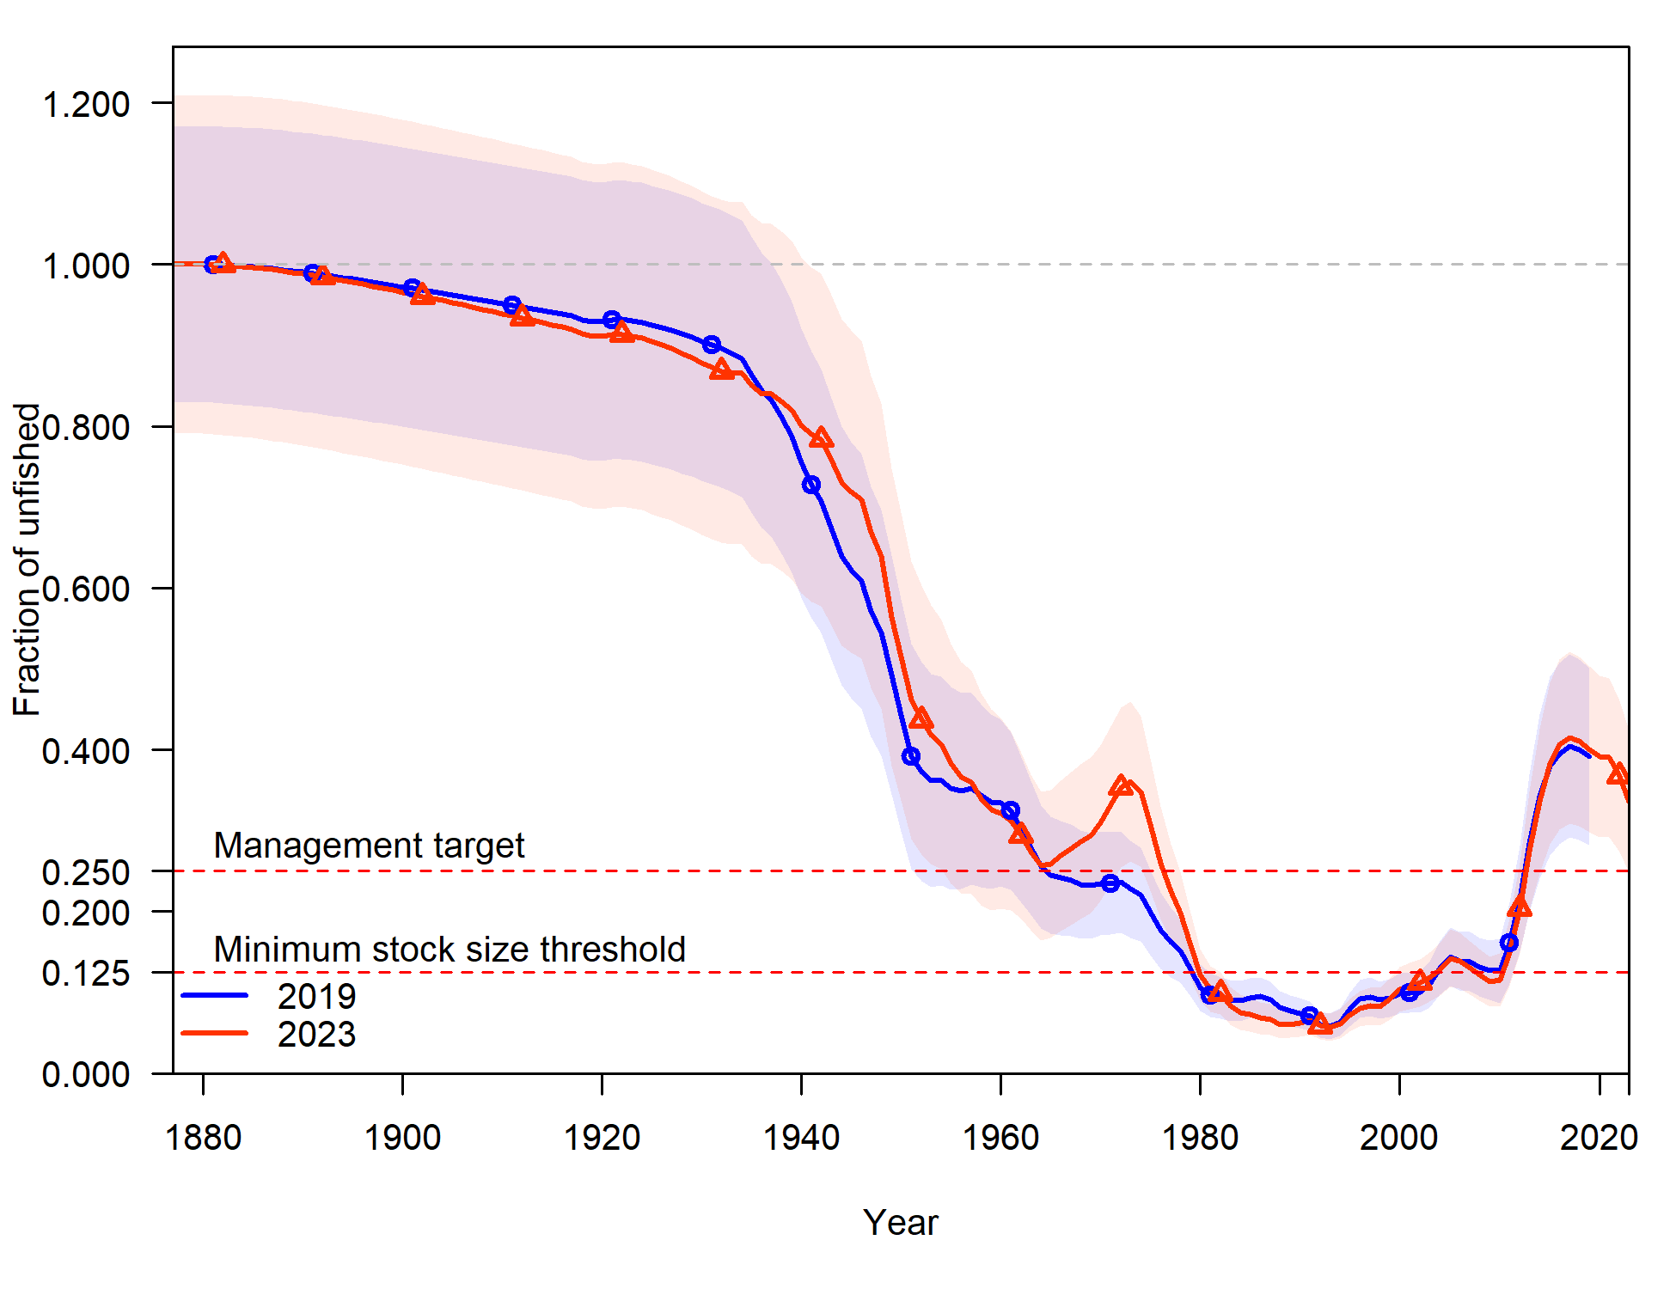
Comparison to previous assessments
Spawning biomass
Fraction unfished 2019 vs 2023

Slide 11
Data

Slide 12
Fleet structure
Single coastwide stock
Removals are divided into North (WA-OR) and South (CA) fleets
to account for differences in exploitation history
Single Gear Fleets (>98% Trawl)

Slide 13
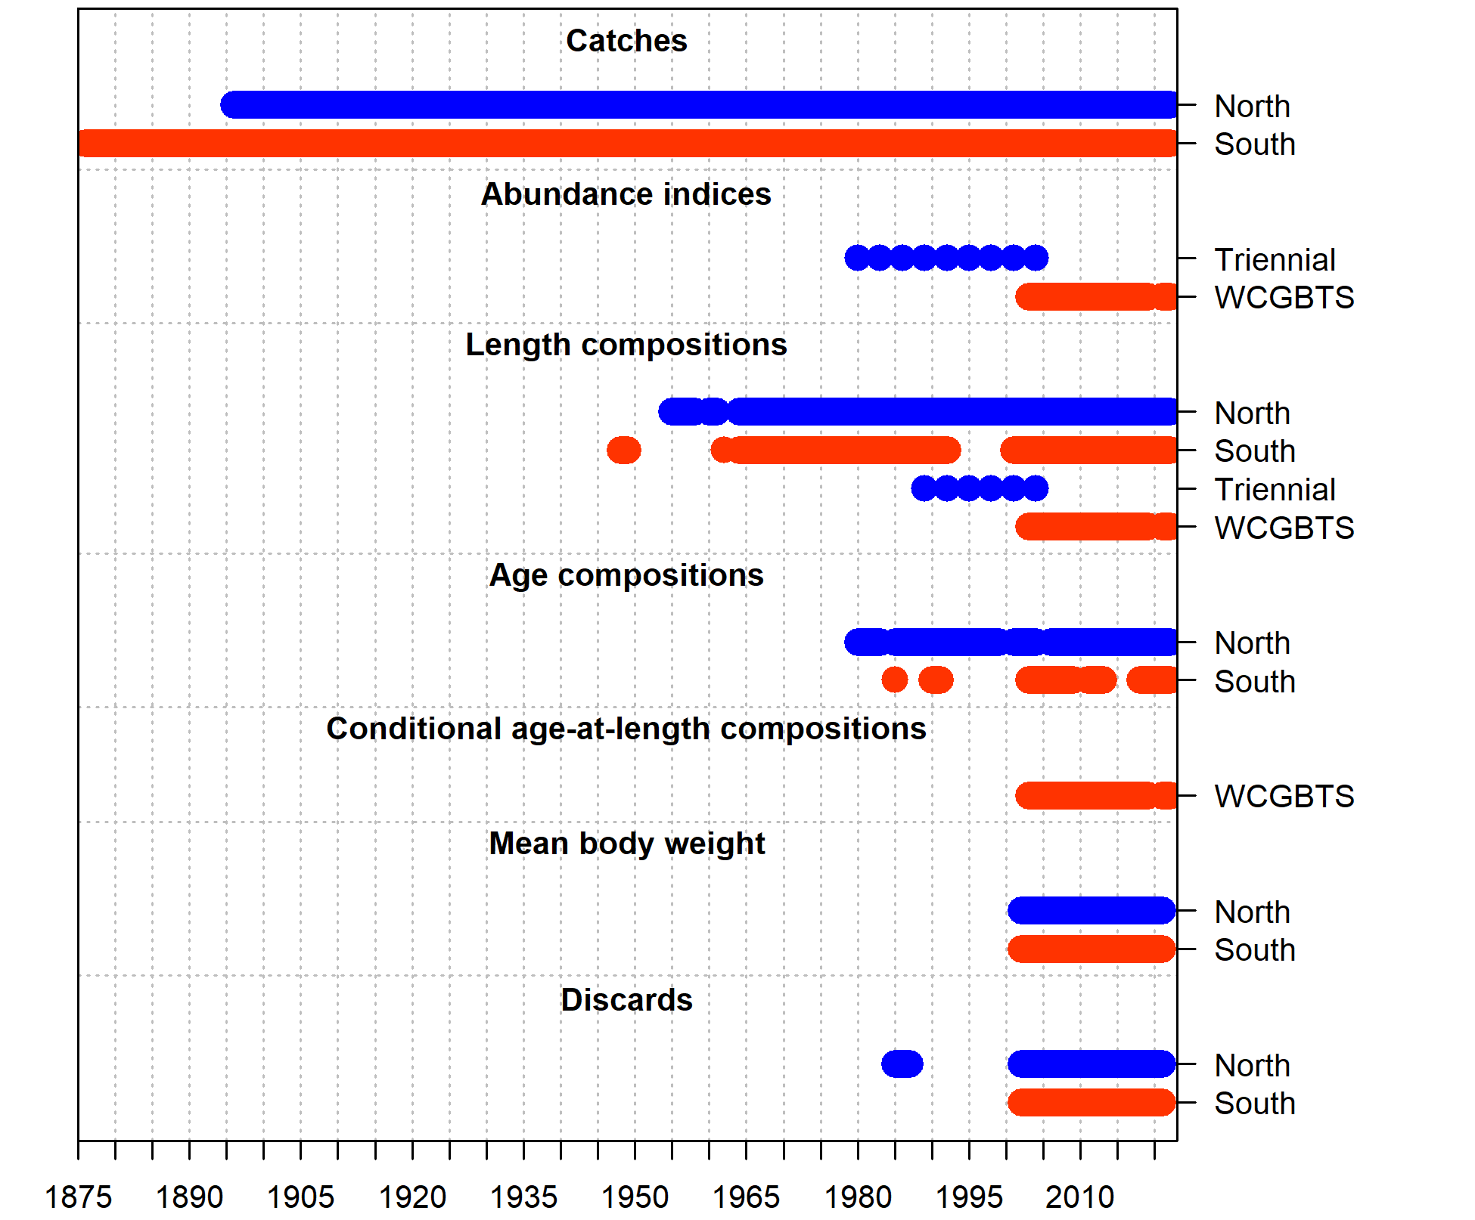
Summary of data sources

Slide 14
Commercial landings
Reconstructed by state
Recent landings are from PacFIN and state agencies
Historical landings are provided by state agencies
CA – no changes from last assessment.
OR – no changes from last assessment.
WA - new historical landings provided by WDFW.

Slide 15
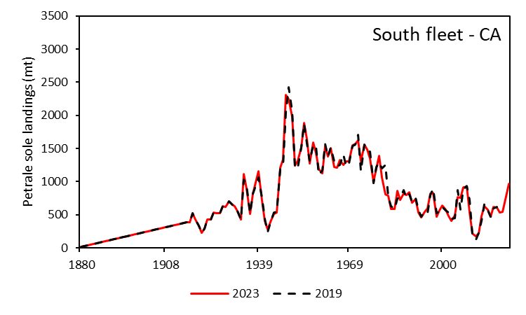
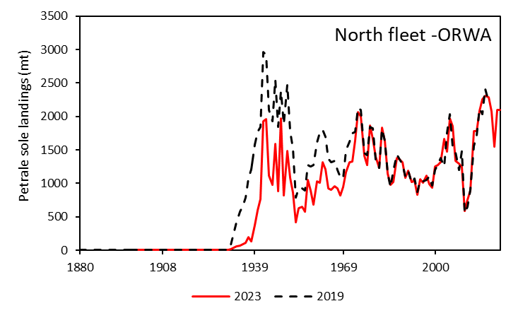
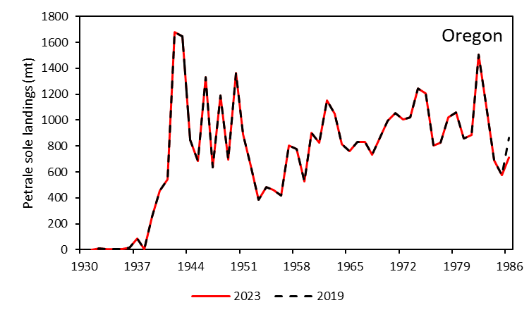
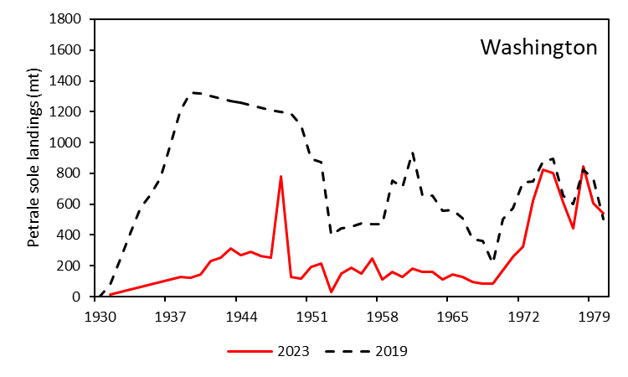
Historical landings update

Slide 16
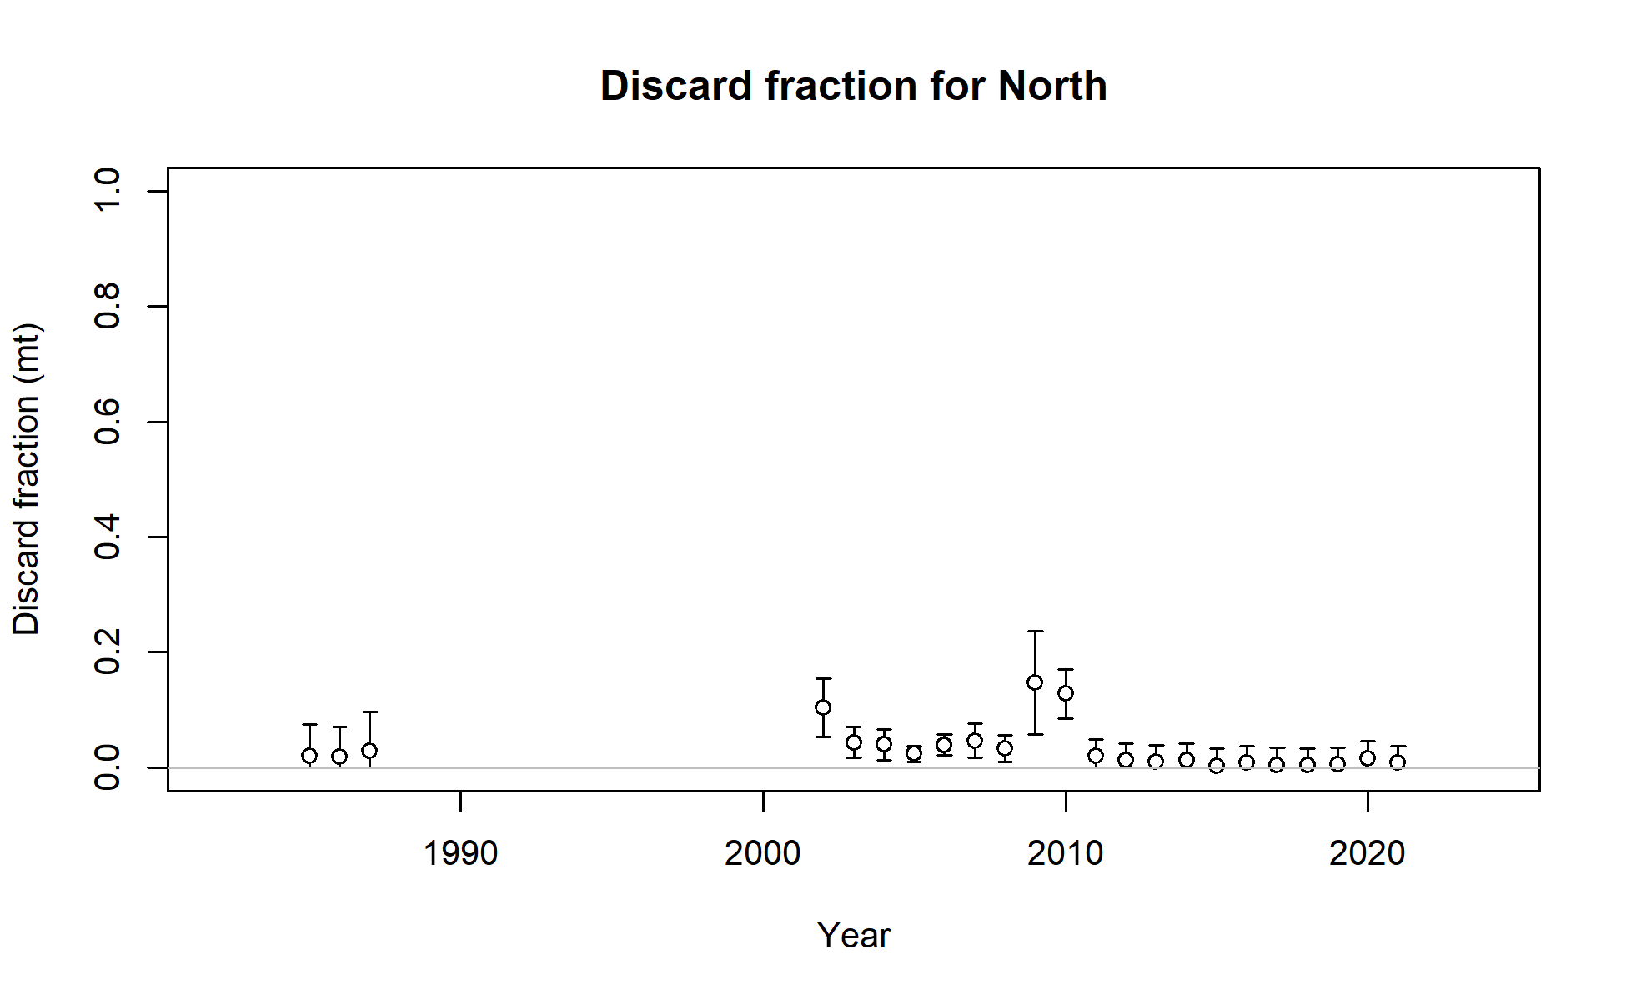
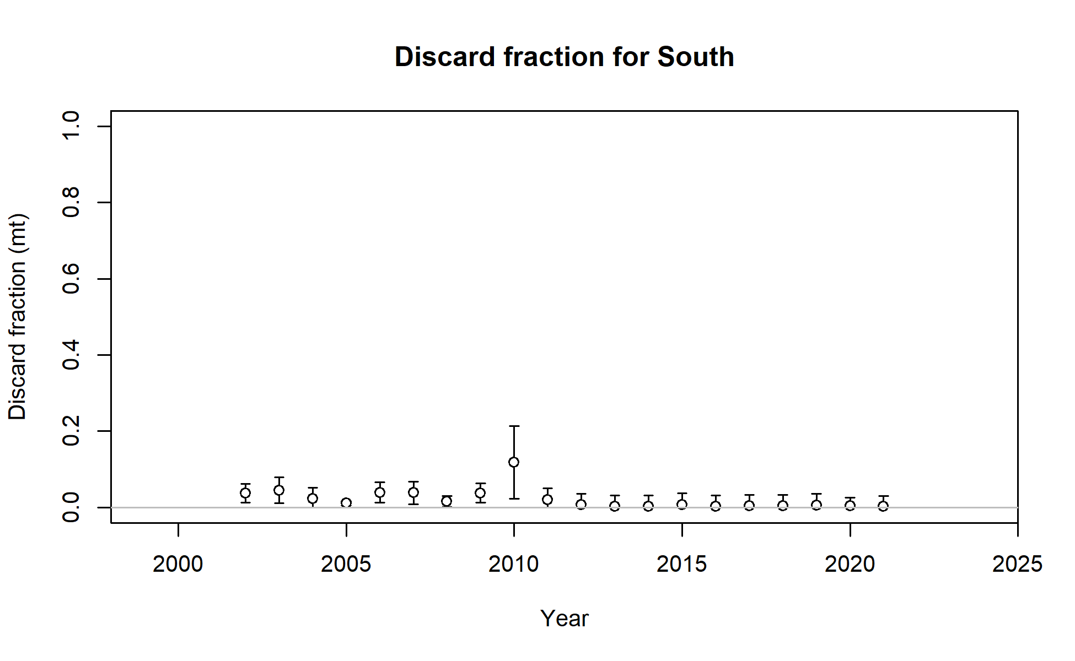
Discard fraction is low
Pikitch
WCGOP
WCGOP

Slide 17
Fishery length and age compositions
From PacFIN and CalCOM for retained catch, and from WCGOP for discard.
Data quality re-evaluated.
Samples expanded to account for difference in catch among trips, and then for difference in catch between states (for North fleet).

Slide 18
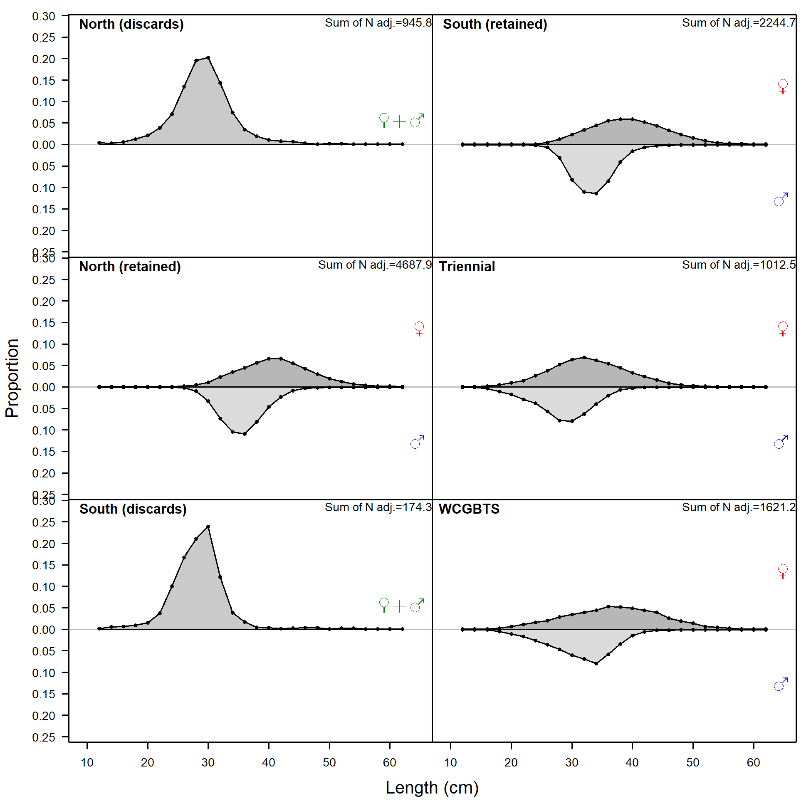
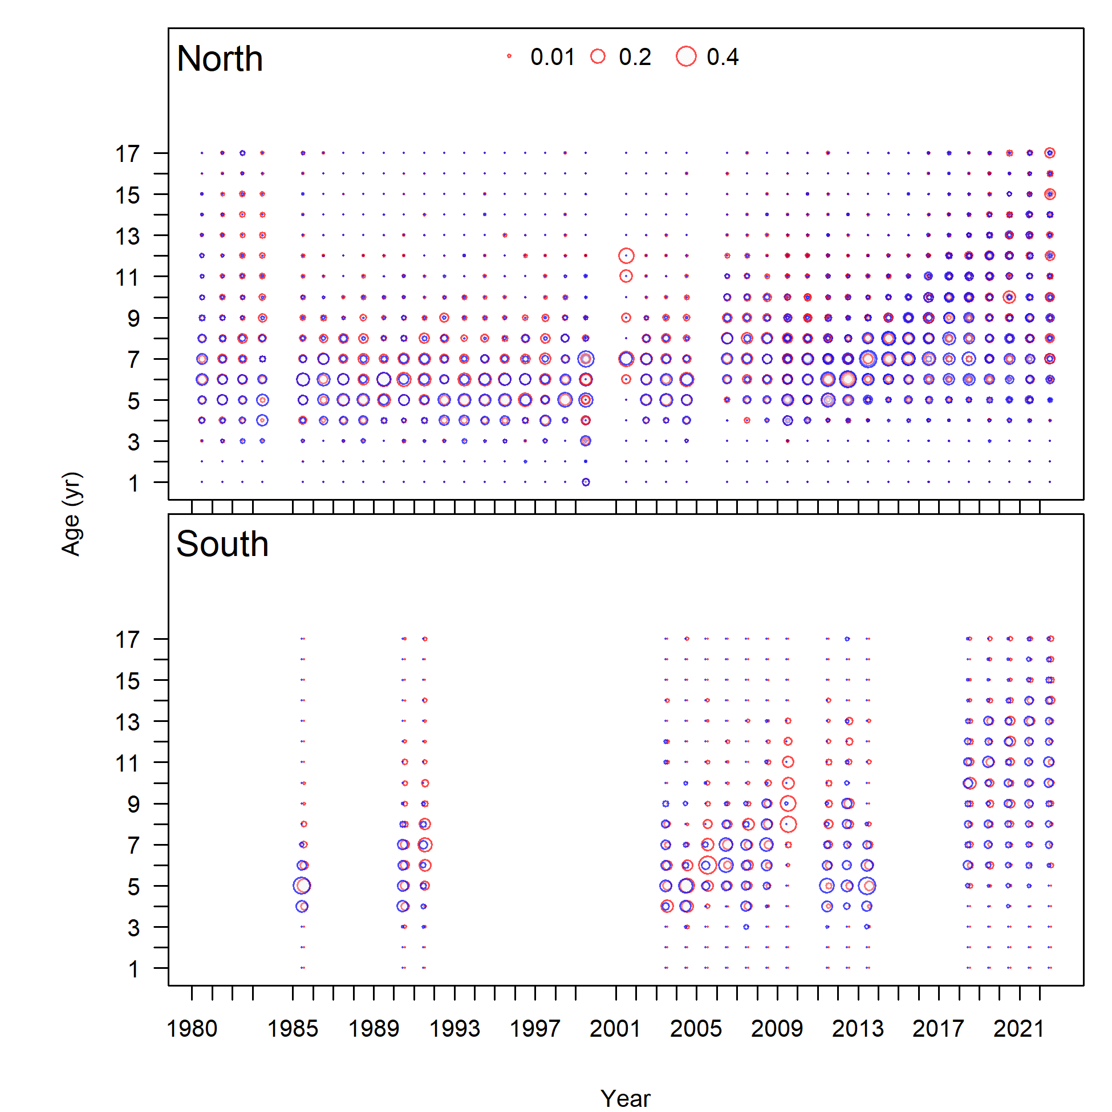
Fishery length compositions
Fishery age compositions

Slide 19
Fishery-independent data
Included in the assessment:
AFSC triennial shelf survey (Triennial)
NWFSC West Coast Groundfish Bottom Trawl Survey (WCGBTS)

Slide 20
Indices of abundance
Geostatistical delta model – sdmTMB
Lognormal distribution for the catch-rate component used to better account for extreme catch events.
WCGBTS (2003-2022)

Slide 21
WCGBT Survey index

Slide 22
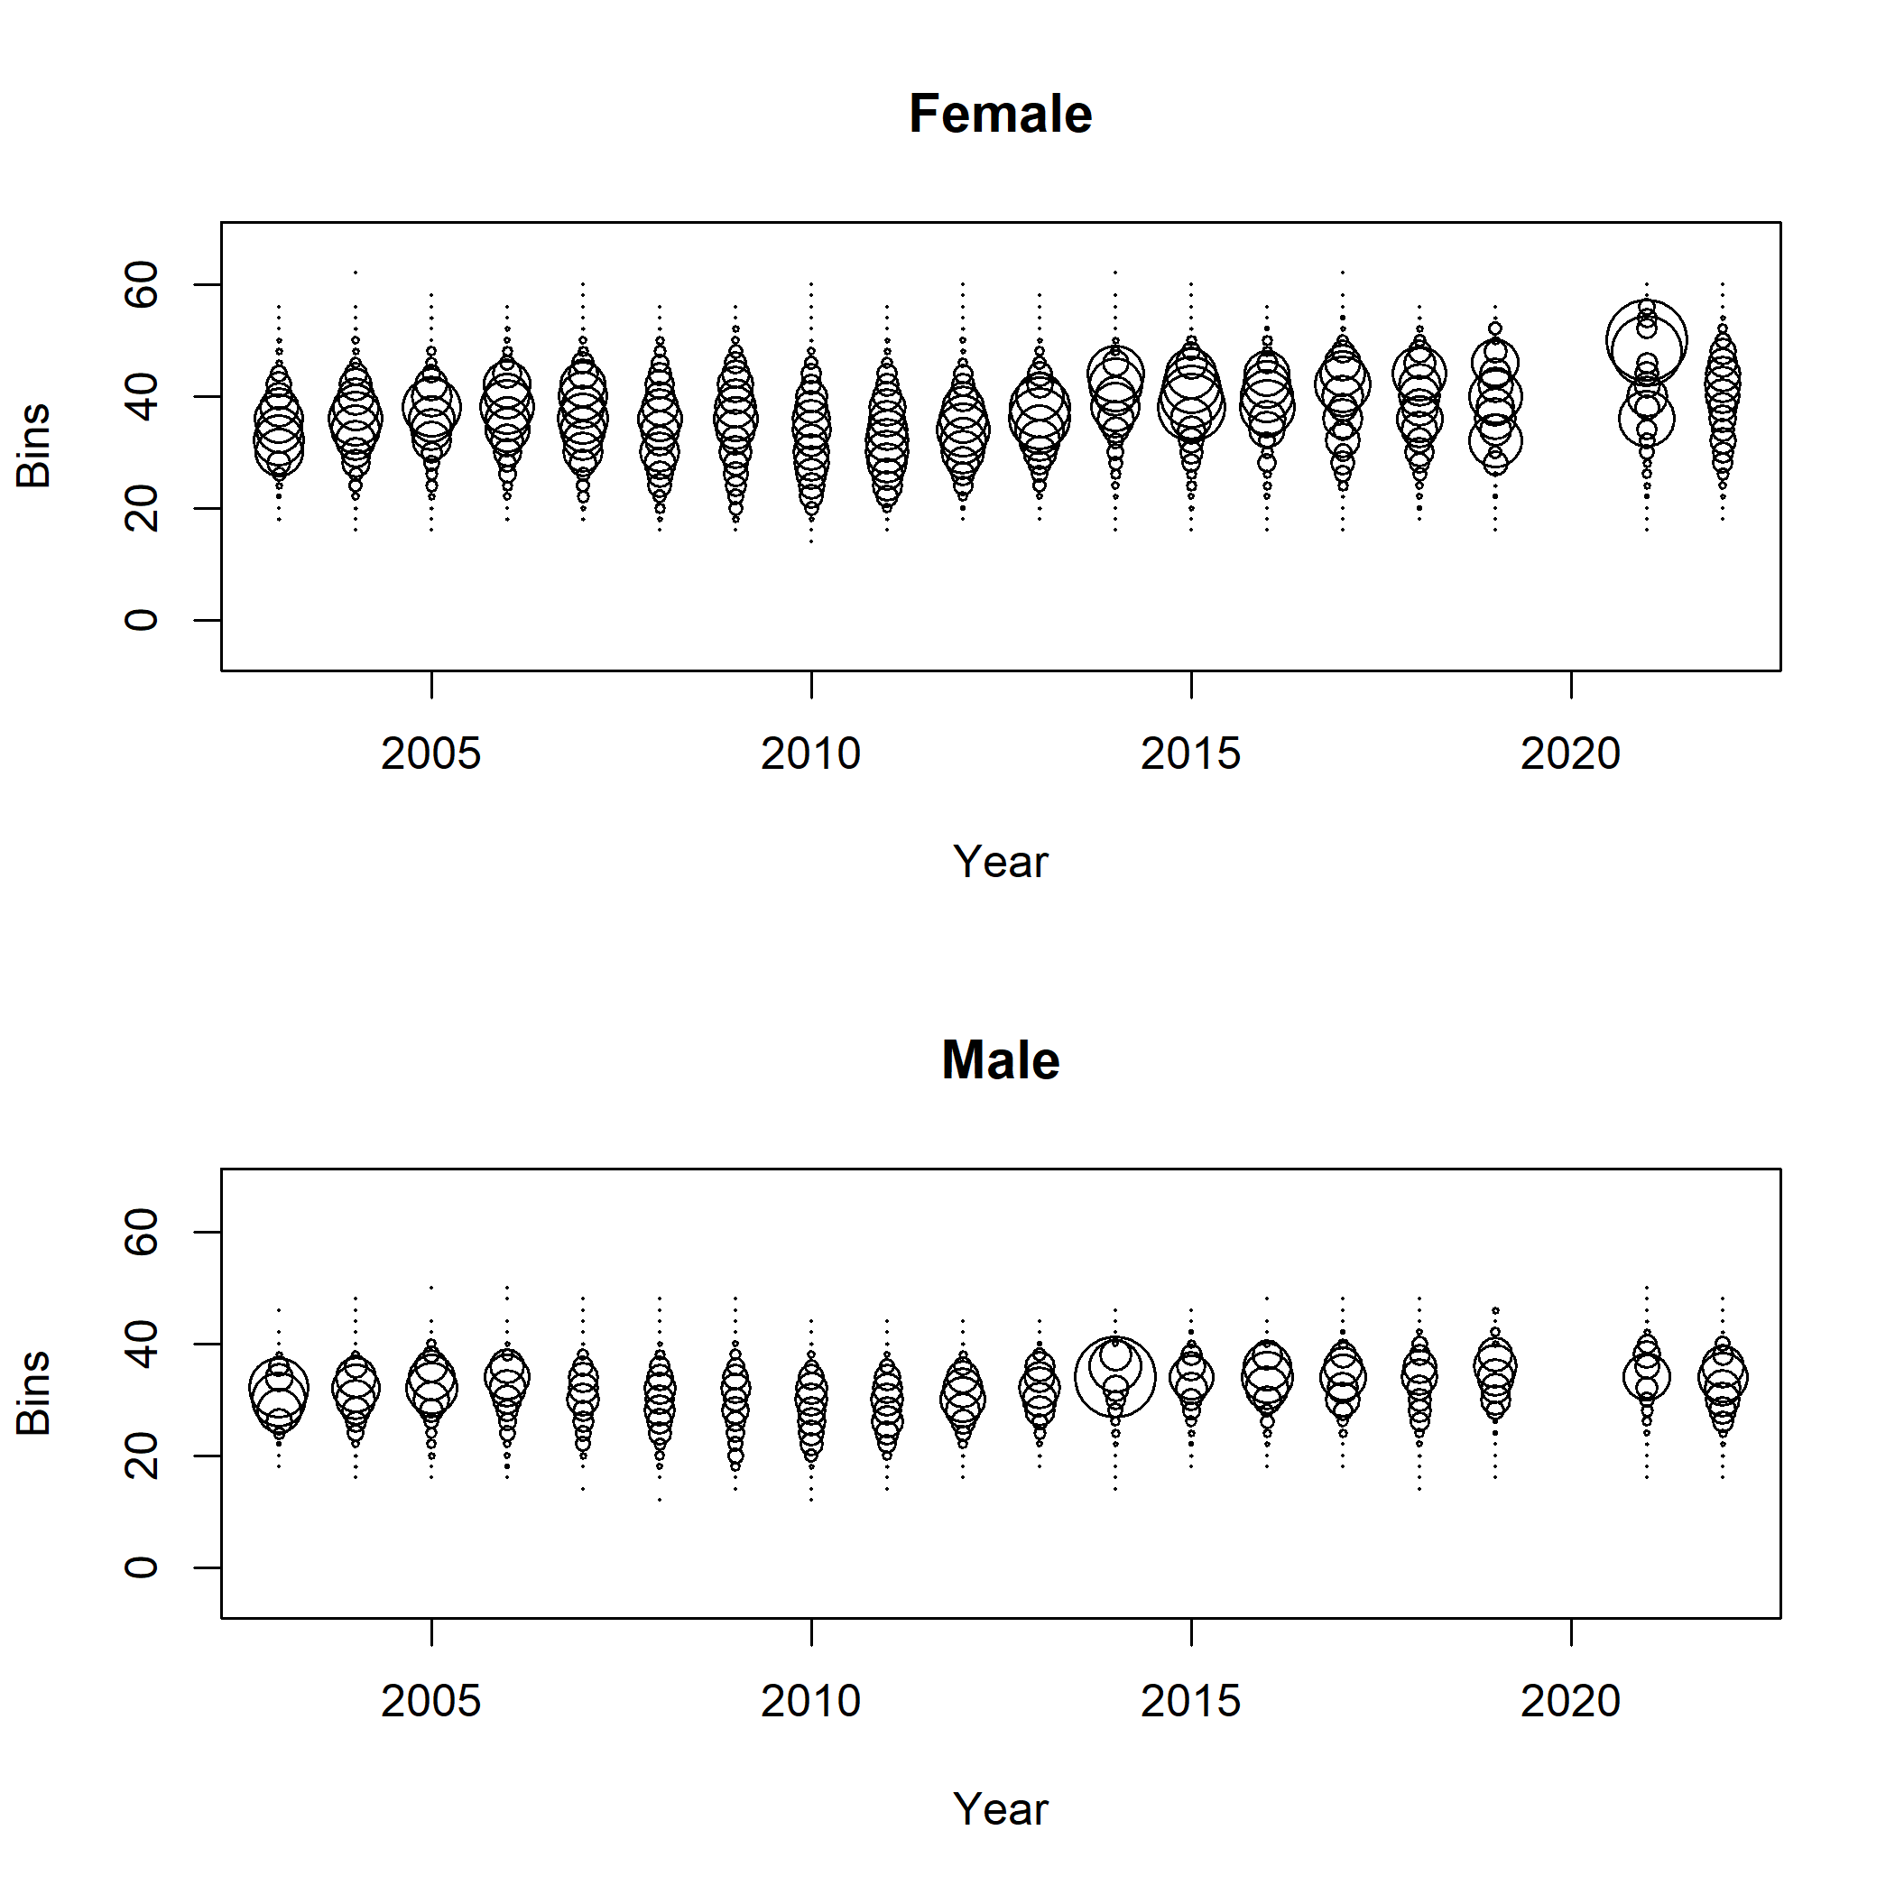
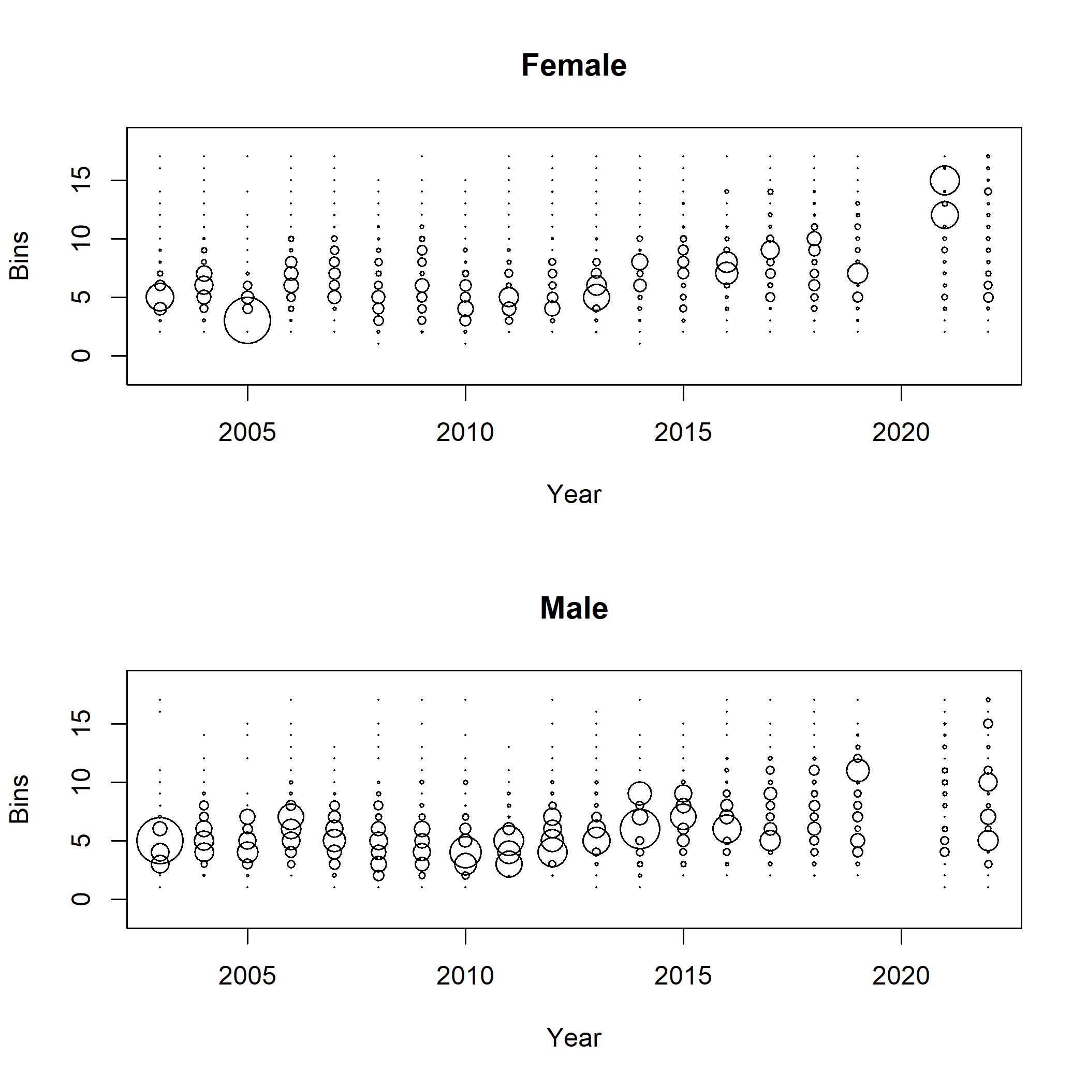
WCGBTS length compositions
Lengths
Ages

Slide 23
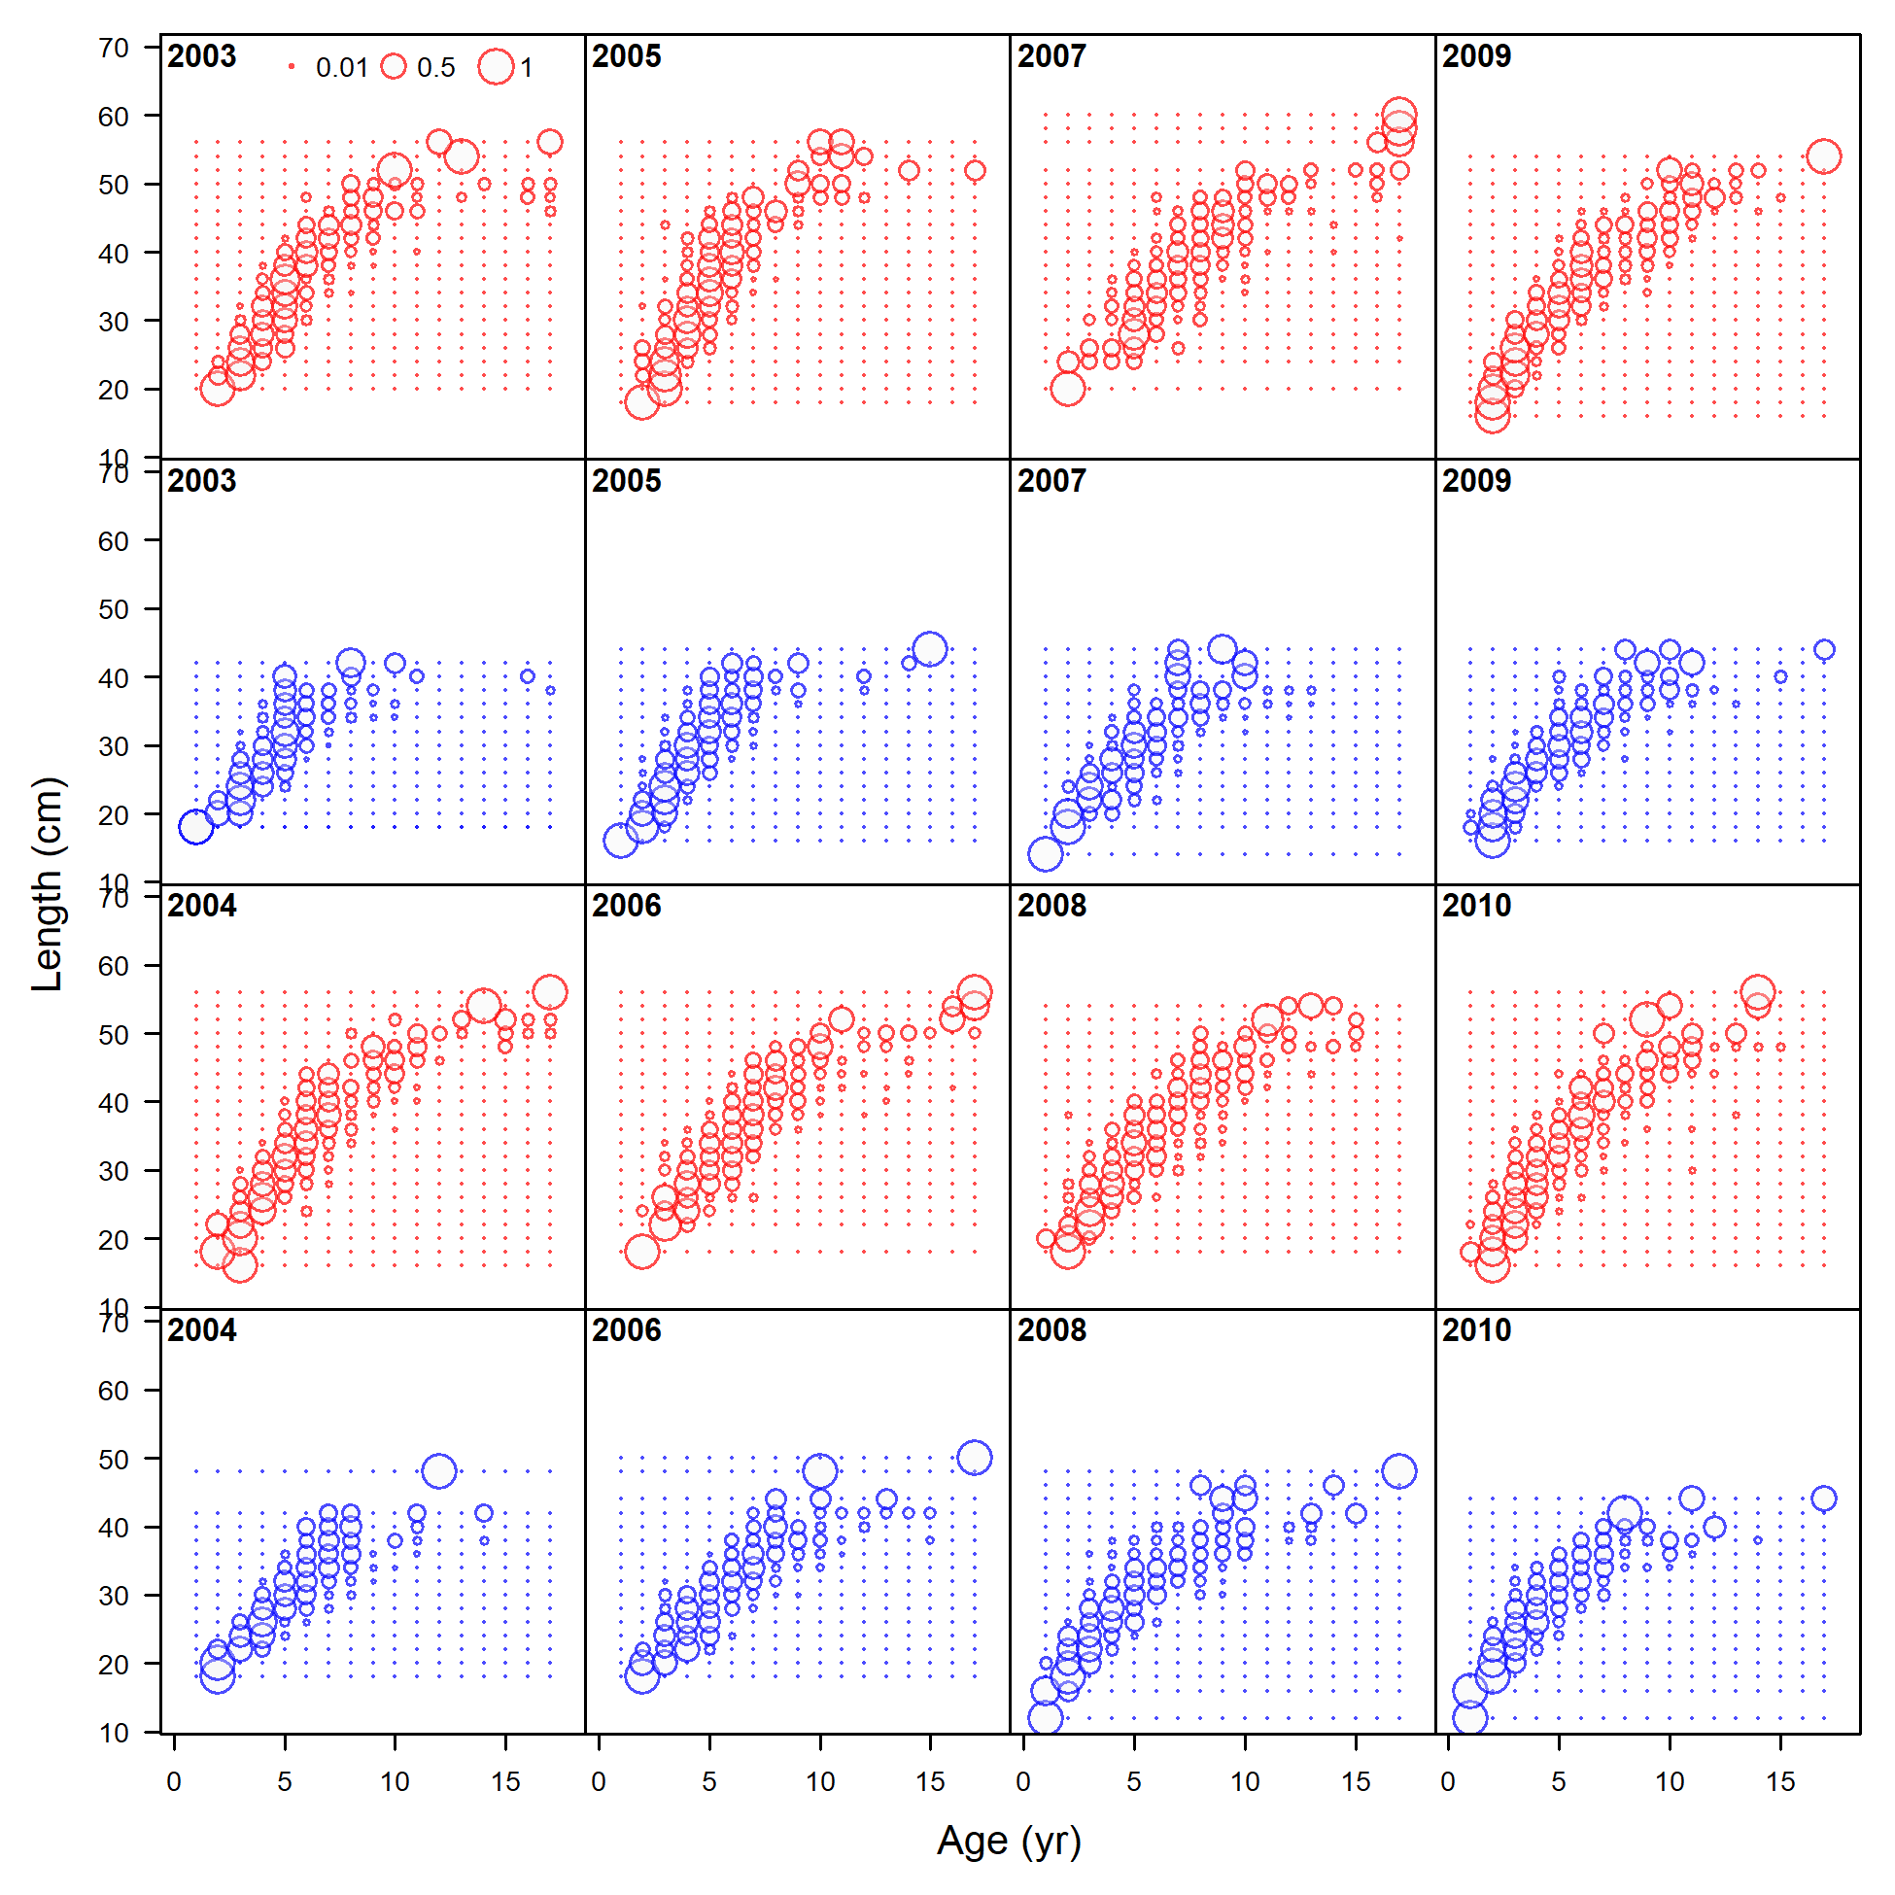
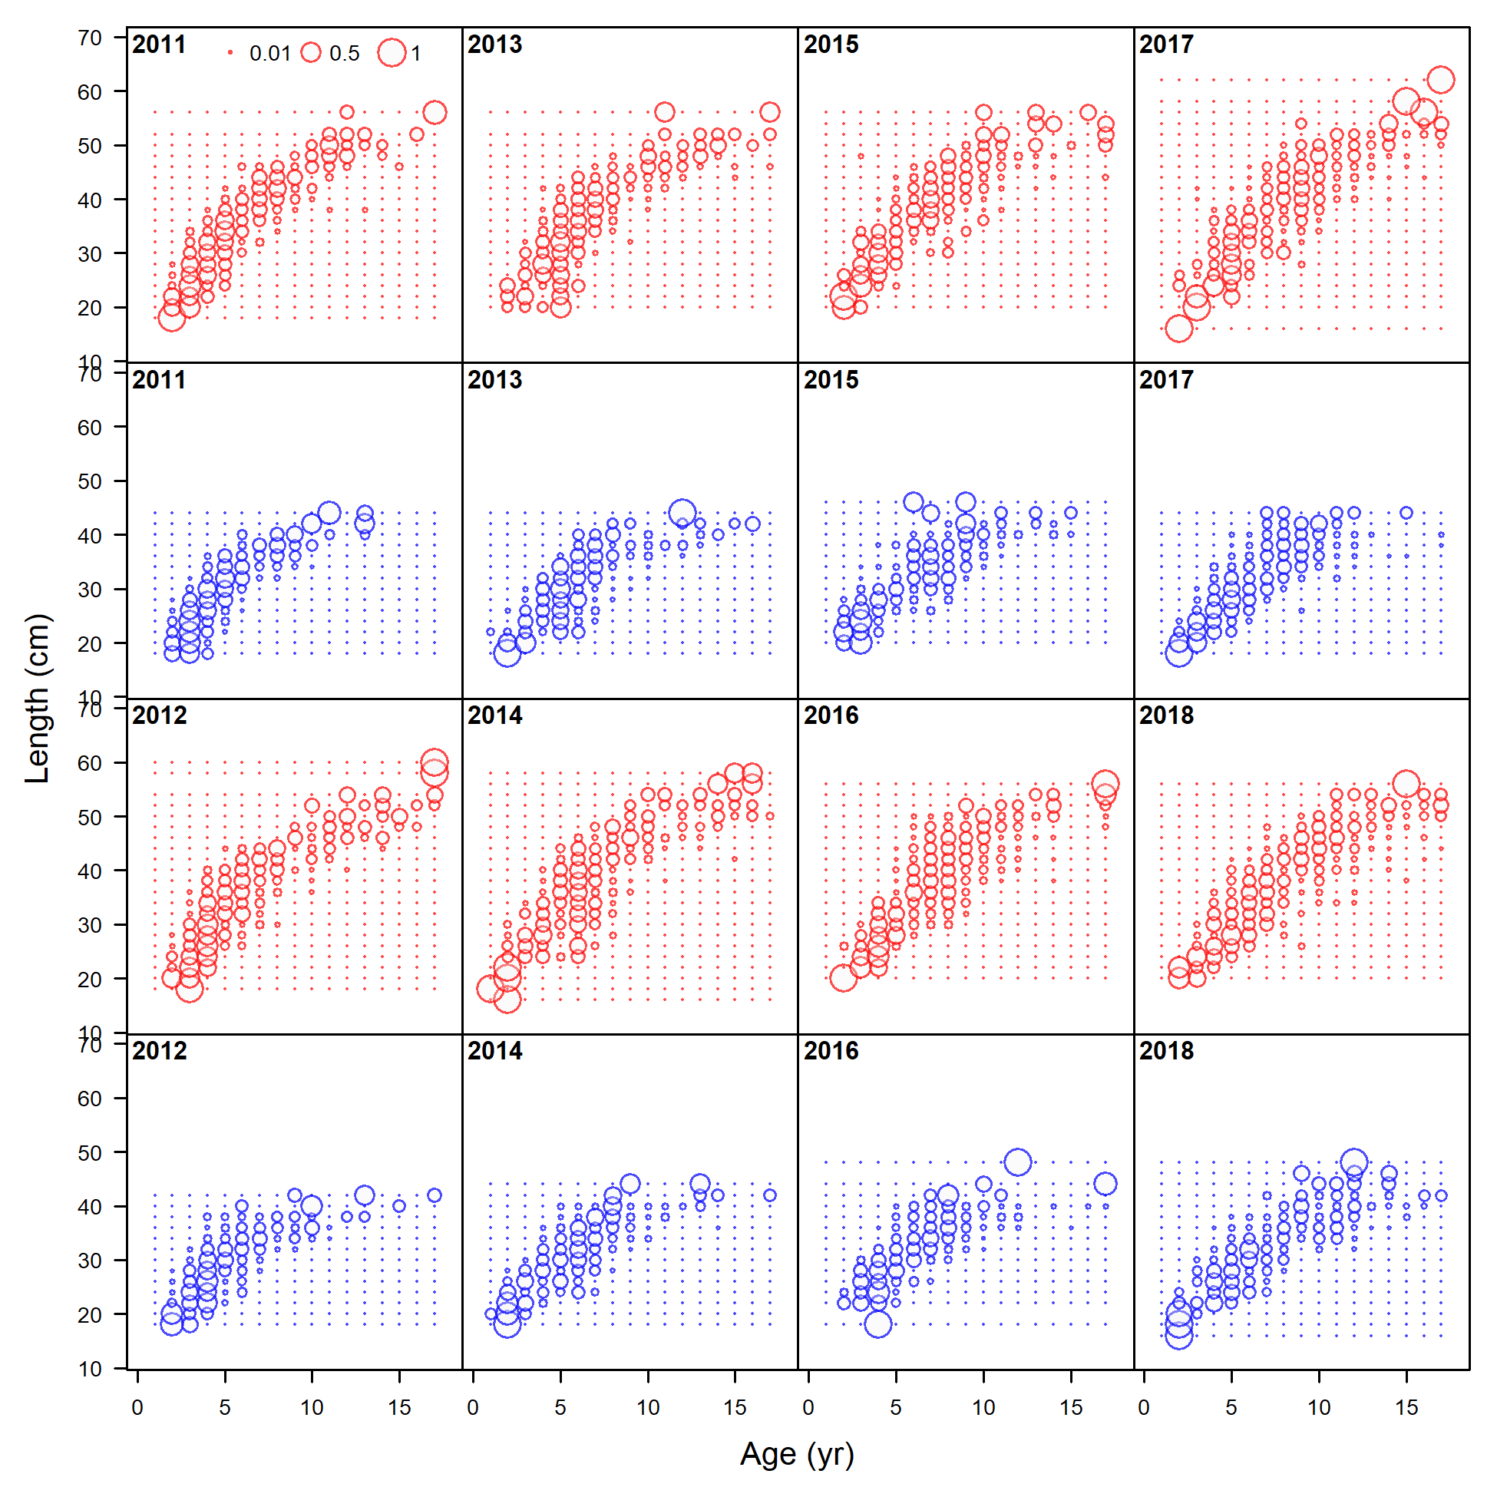
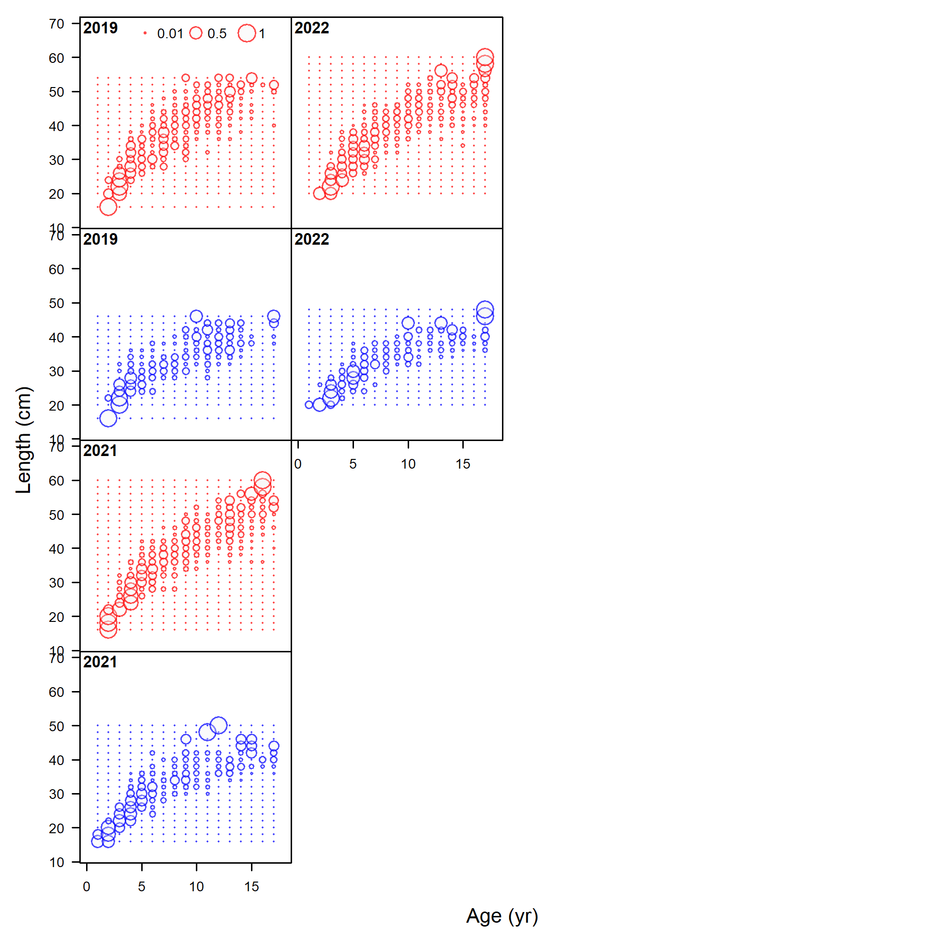
Survey age compositions - CAAL

Slide 24
Biological parameters
Natural mortality
Estimated in the model using Hamel and Cope (2022) prior based on longevity.
Female and male M estimated independently
max age for females = 32 years and for males = 29 years
Growth – fully estimated in the model
Maturity -updated
Fecundity – updated

Slide 25
Model

Slide 26
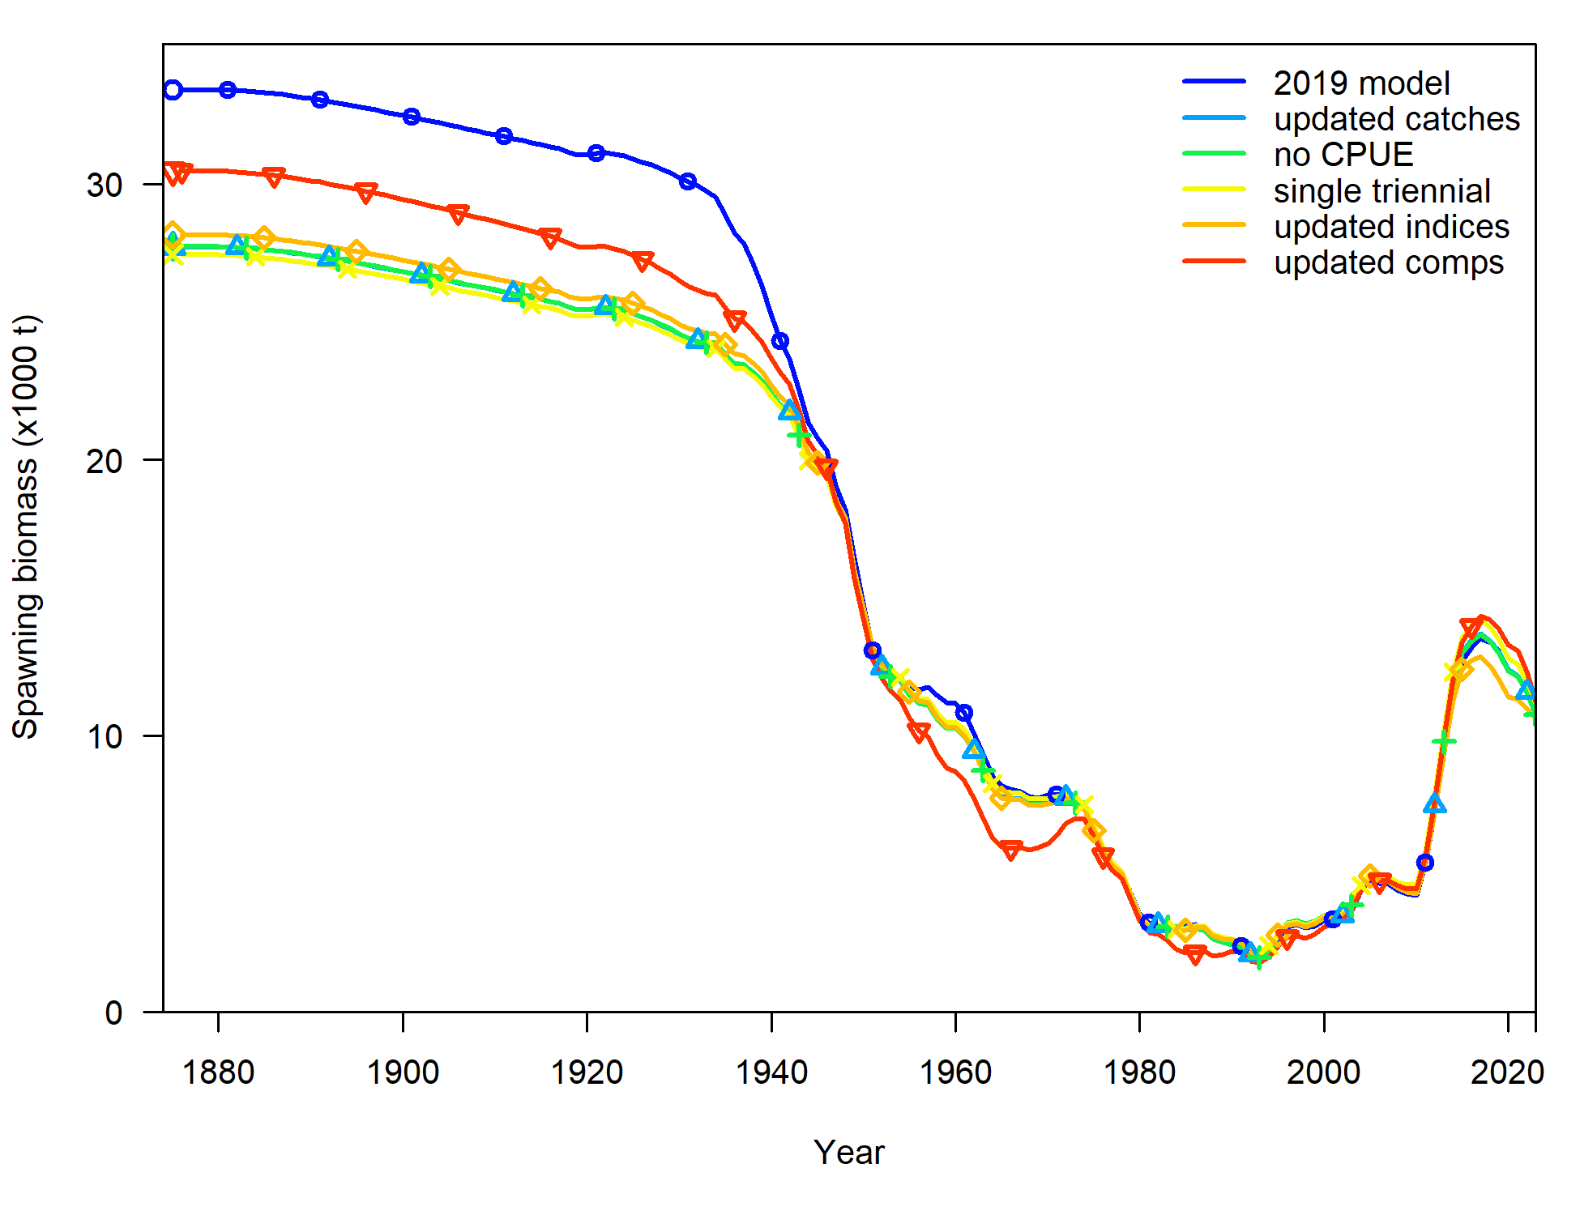
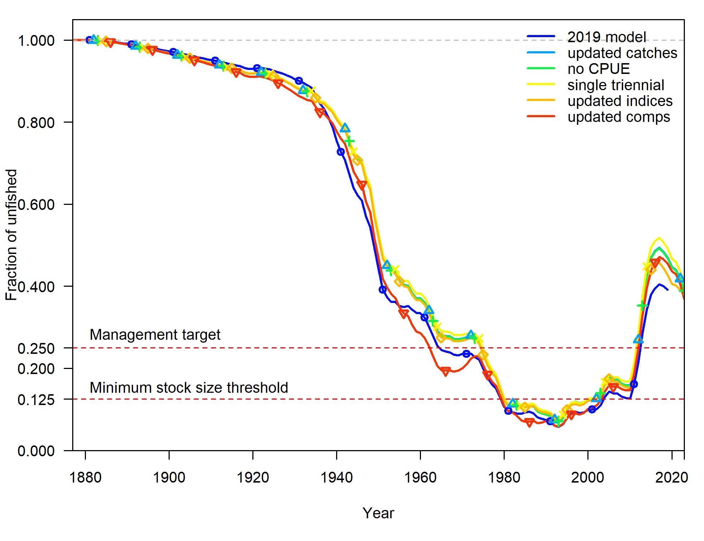
Bridging from 2019 to 2023 model
Spawning biomass
Fraction unfished

Slide 27
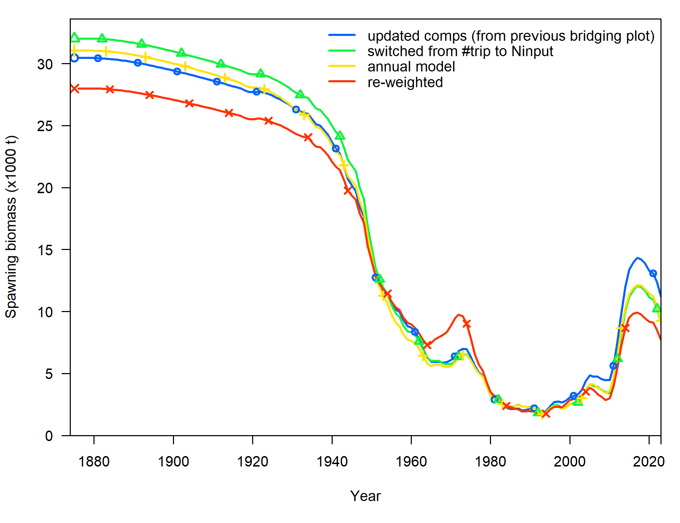
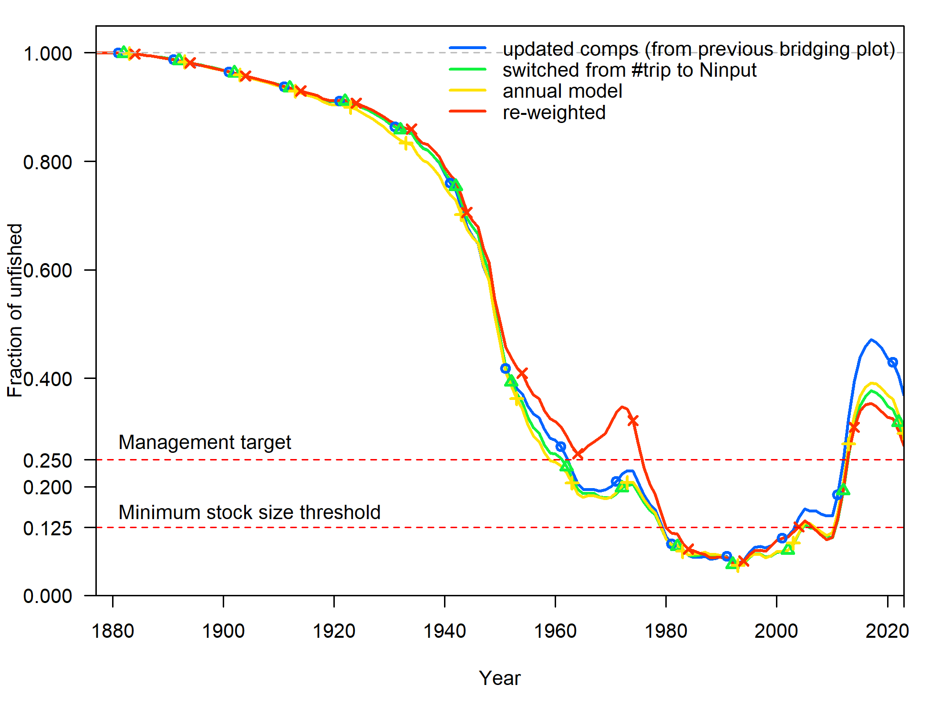
Bridging from 2019 to 2023 model - continued
Spawning biomass
Fraction unfished

Slide 28
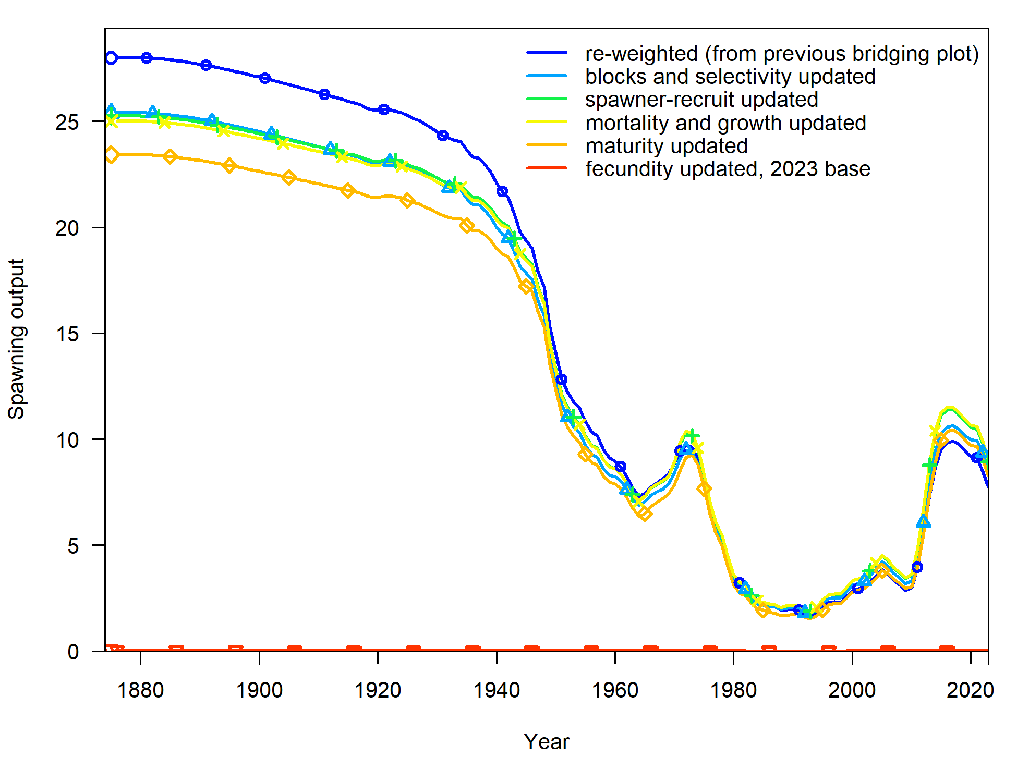
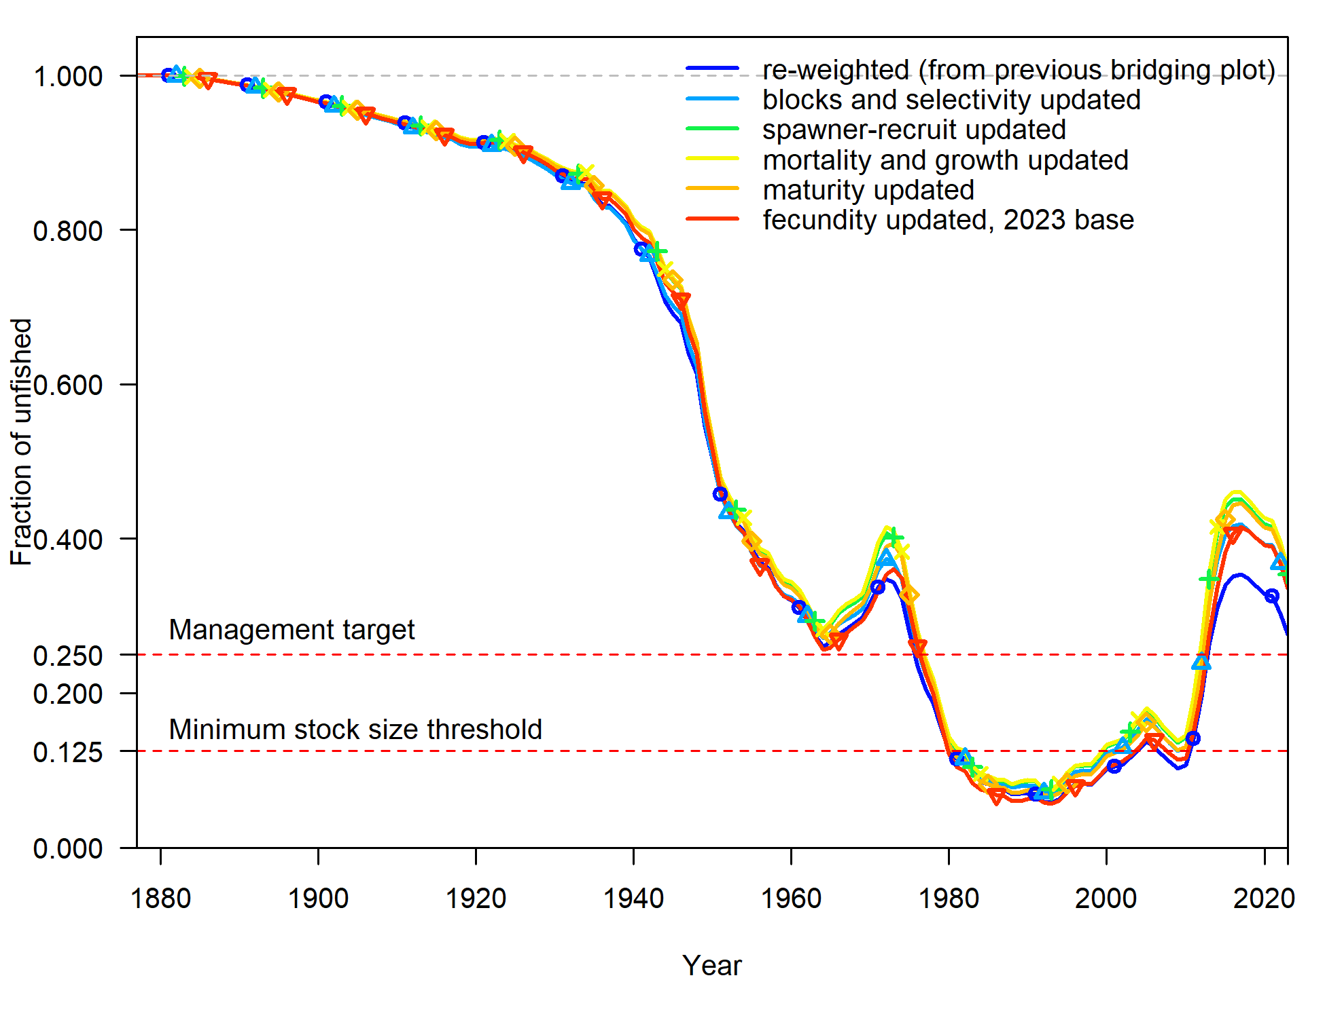
Bridging from 2019 to 2023 model - continued
Spawning biomass
Fraction unfished

Slide 29
Comparison to previous assessments
Spawning biomass
Fraction unfished 2019 vs 2023

Slide 30
Model results

Slide 31
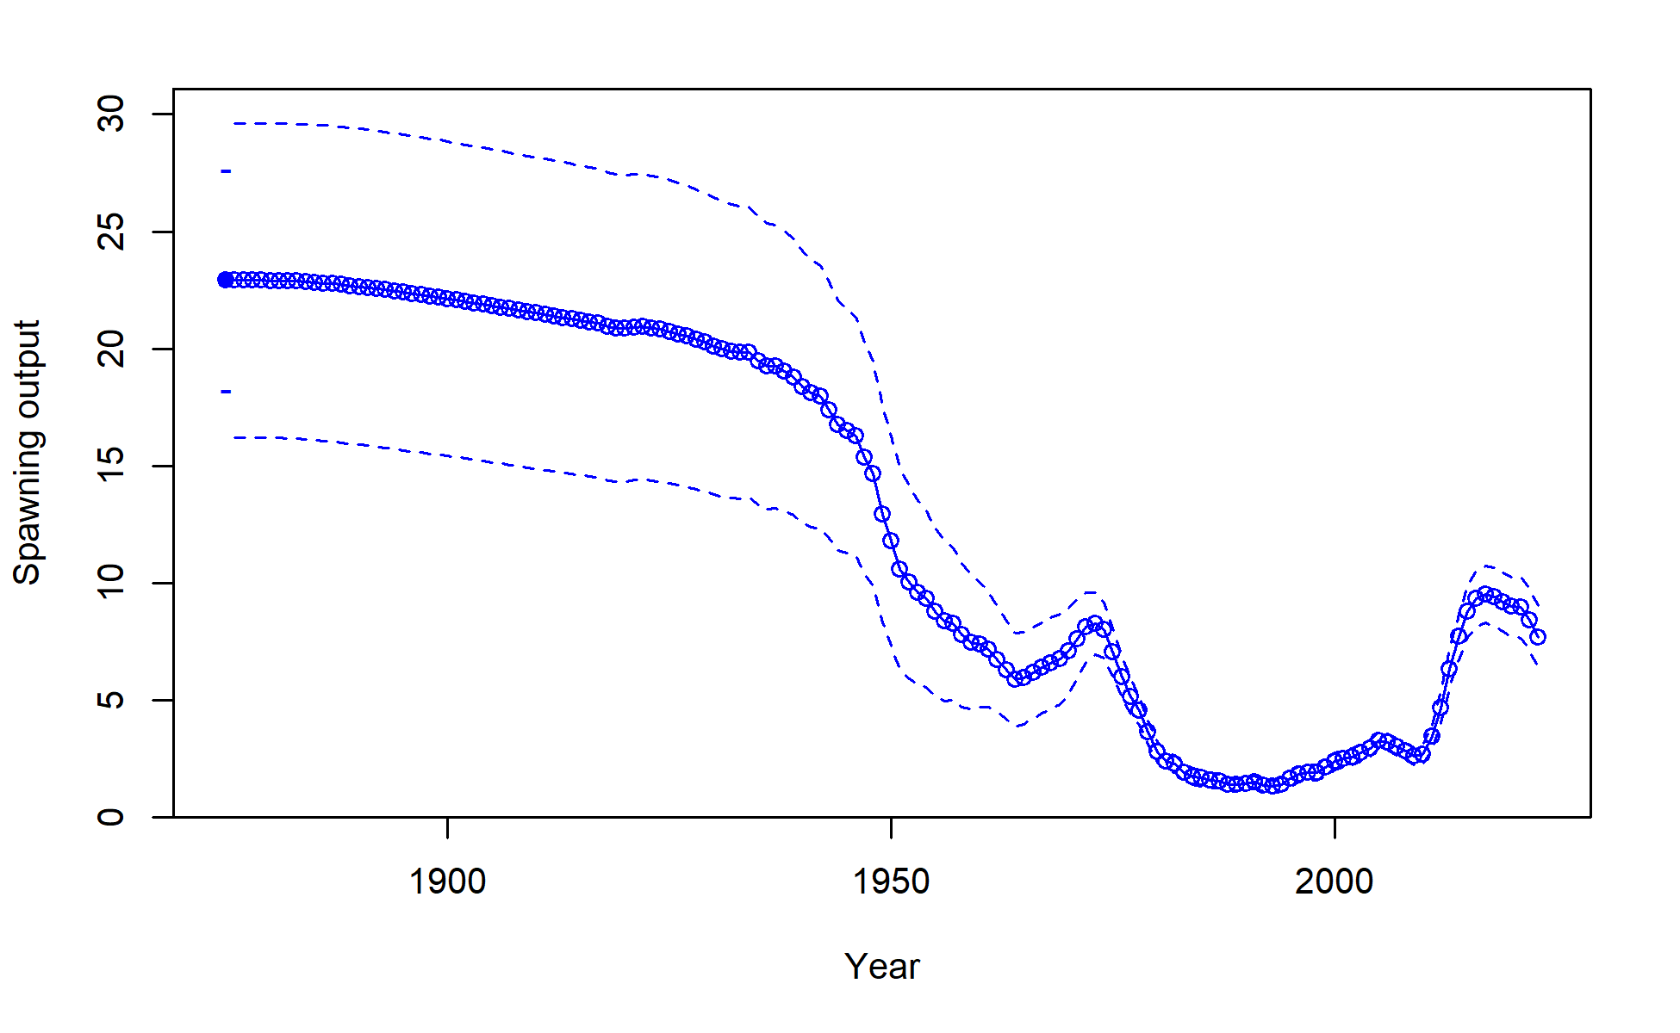
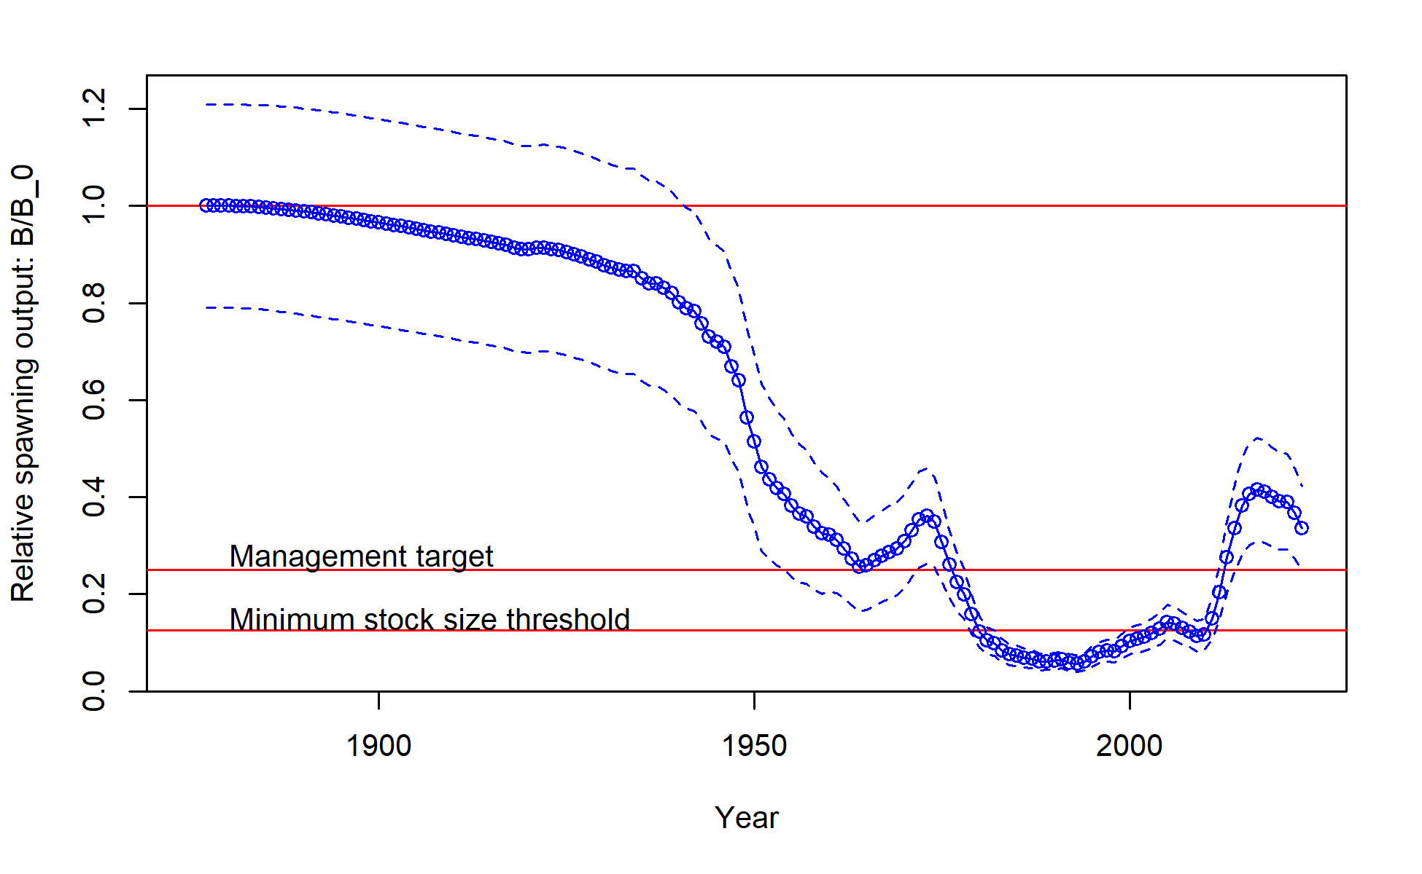
Population trajectory
Spawning biomass
Fraction unfished

Slide 32
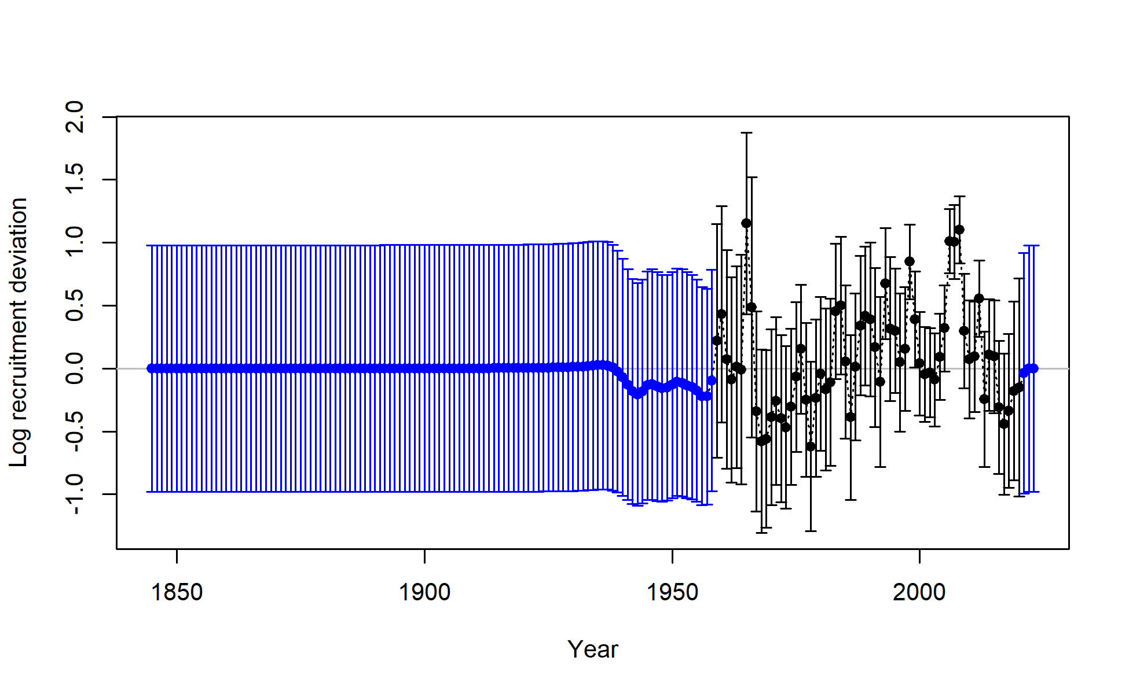
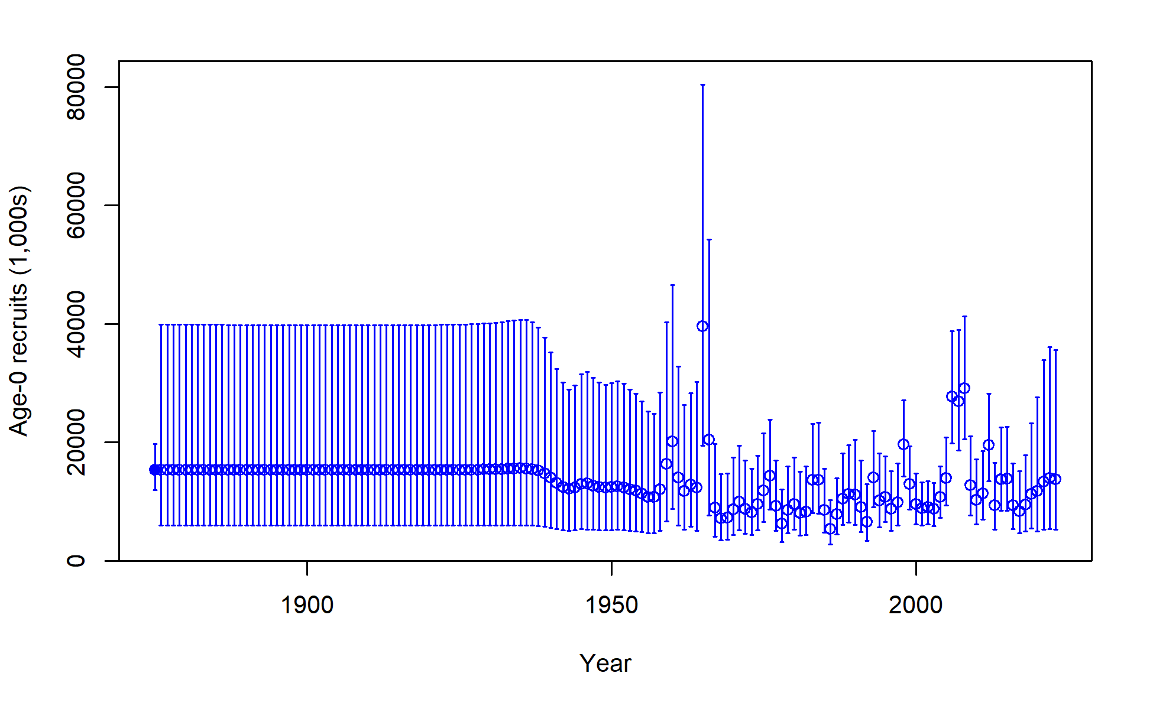
Recruitment deviations
Recruitment
Recruitment deviations

Slide 33
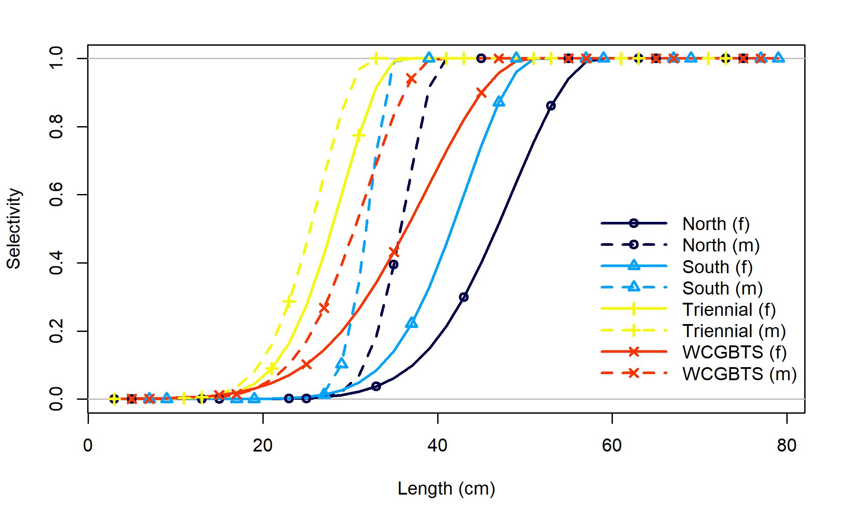
Selectivity and retention

Slide 34
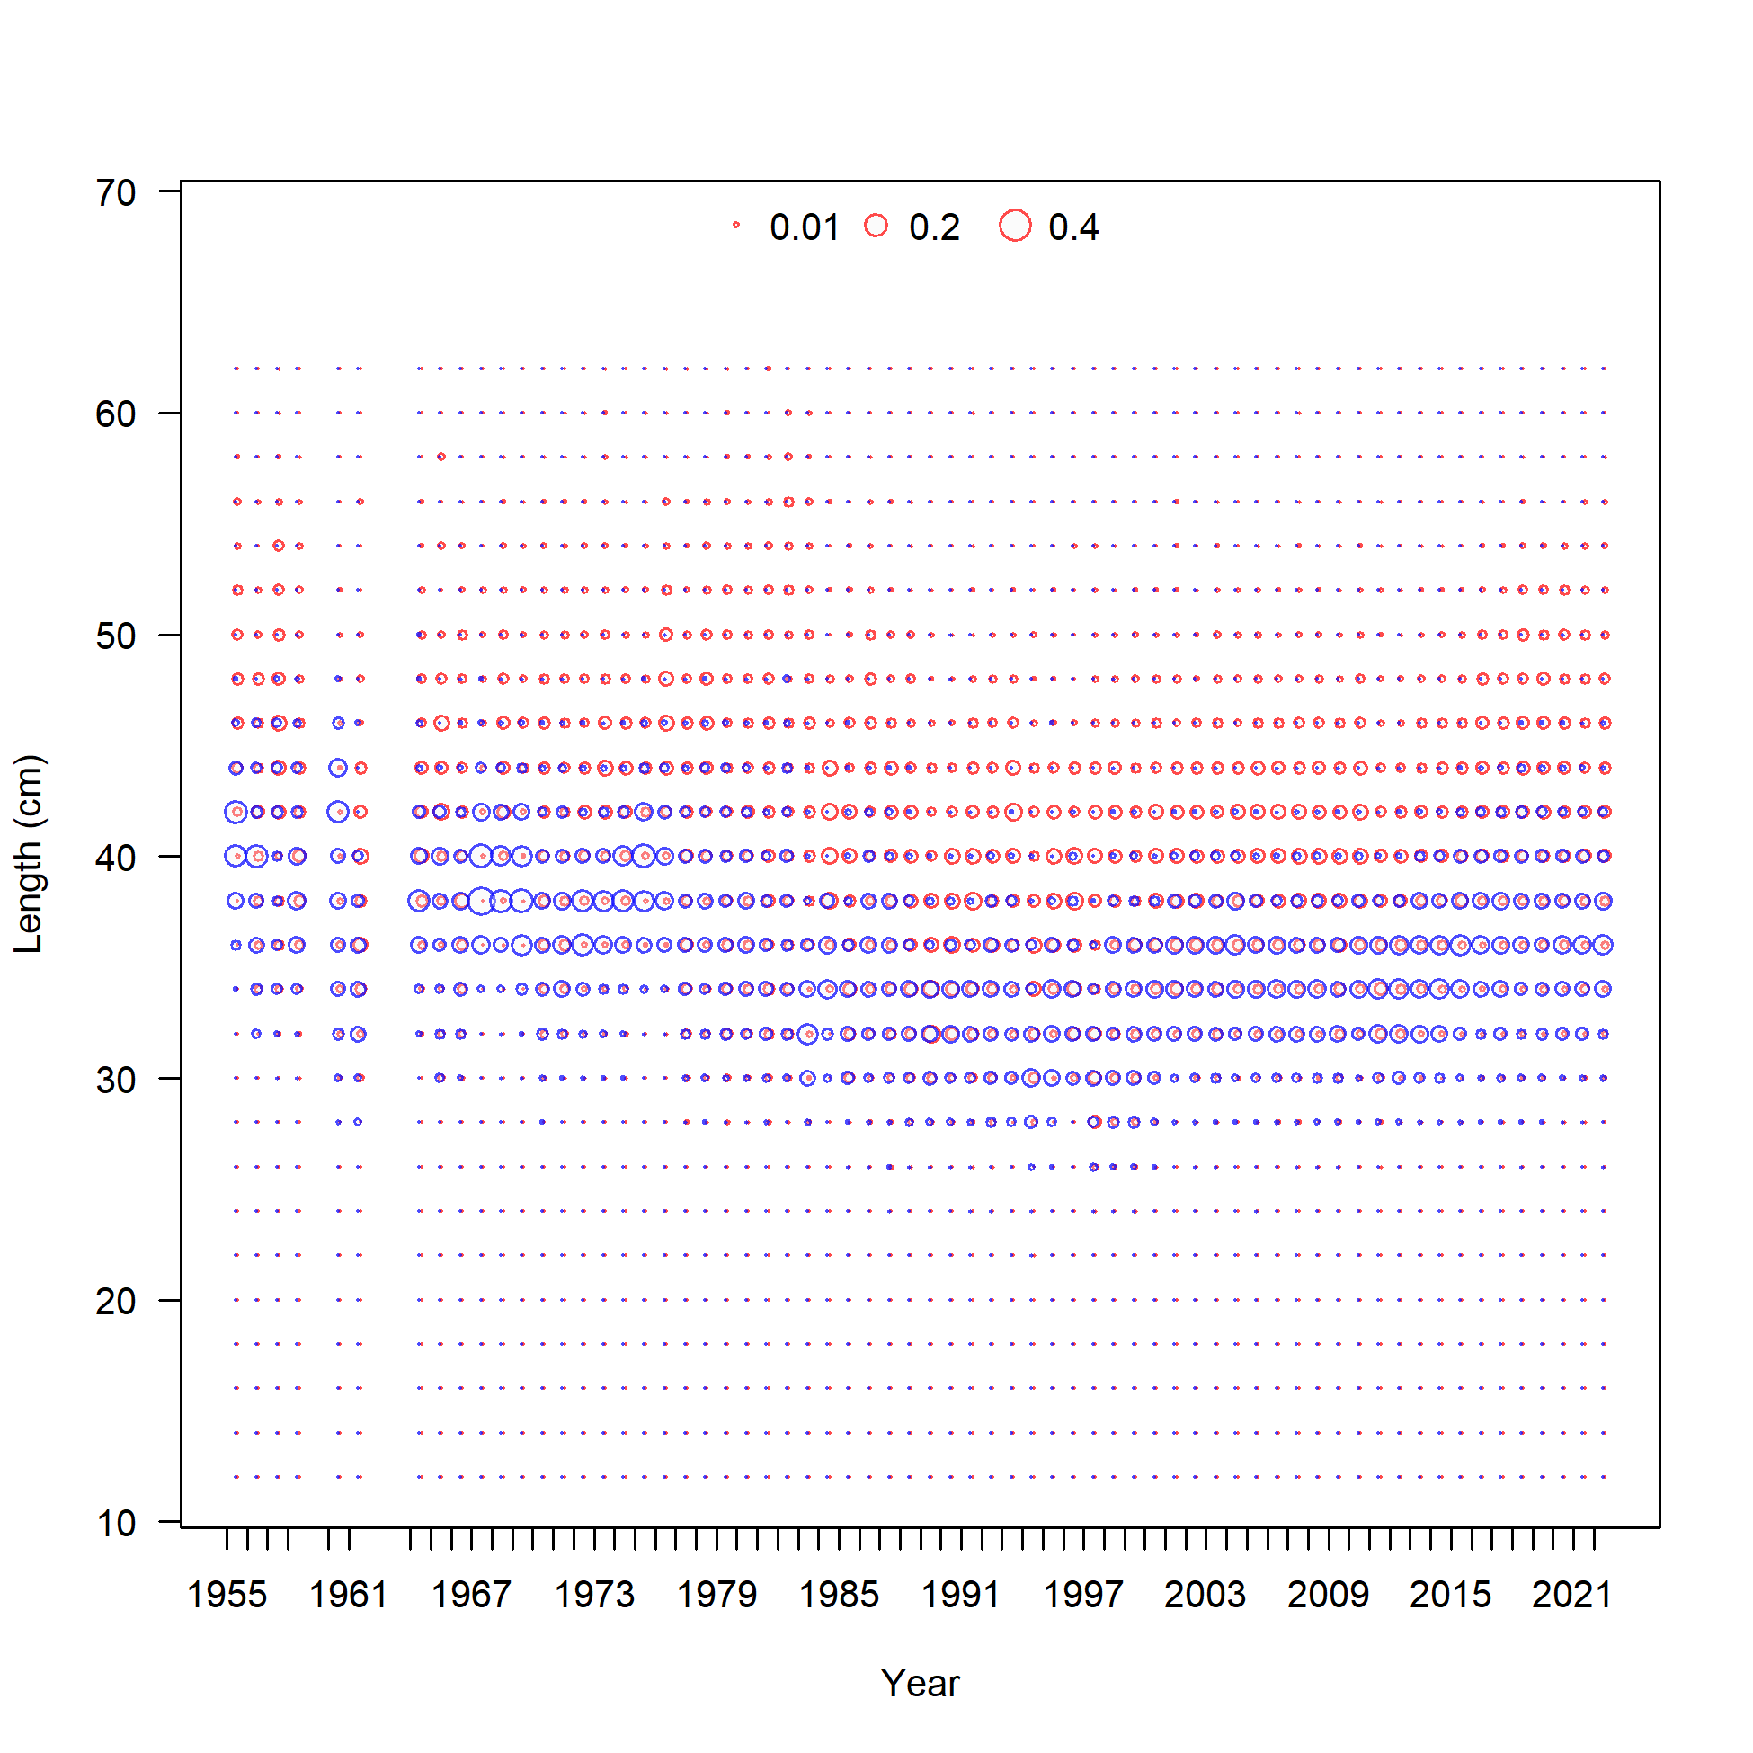
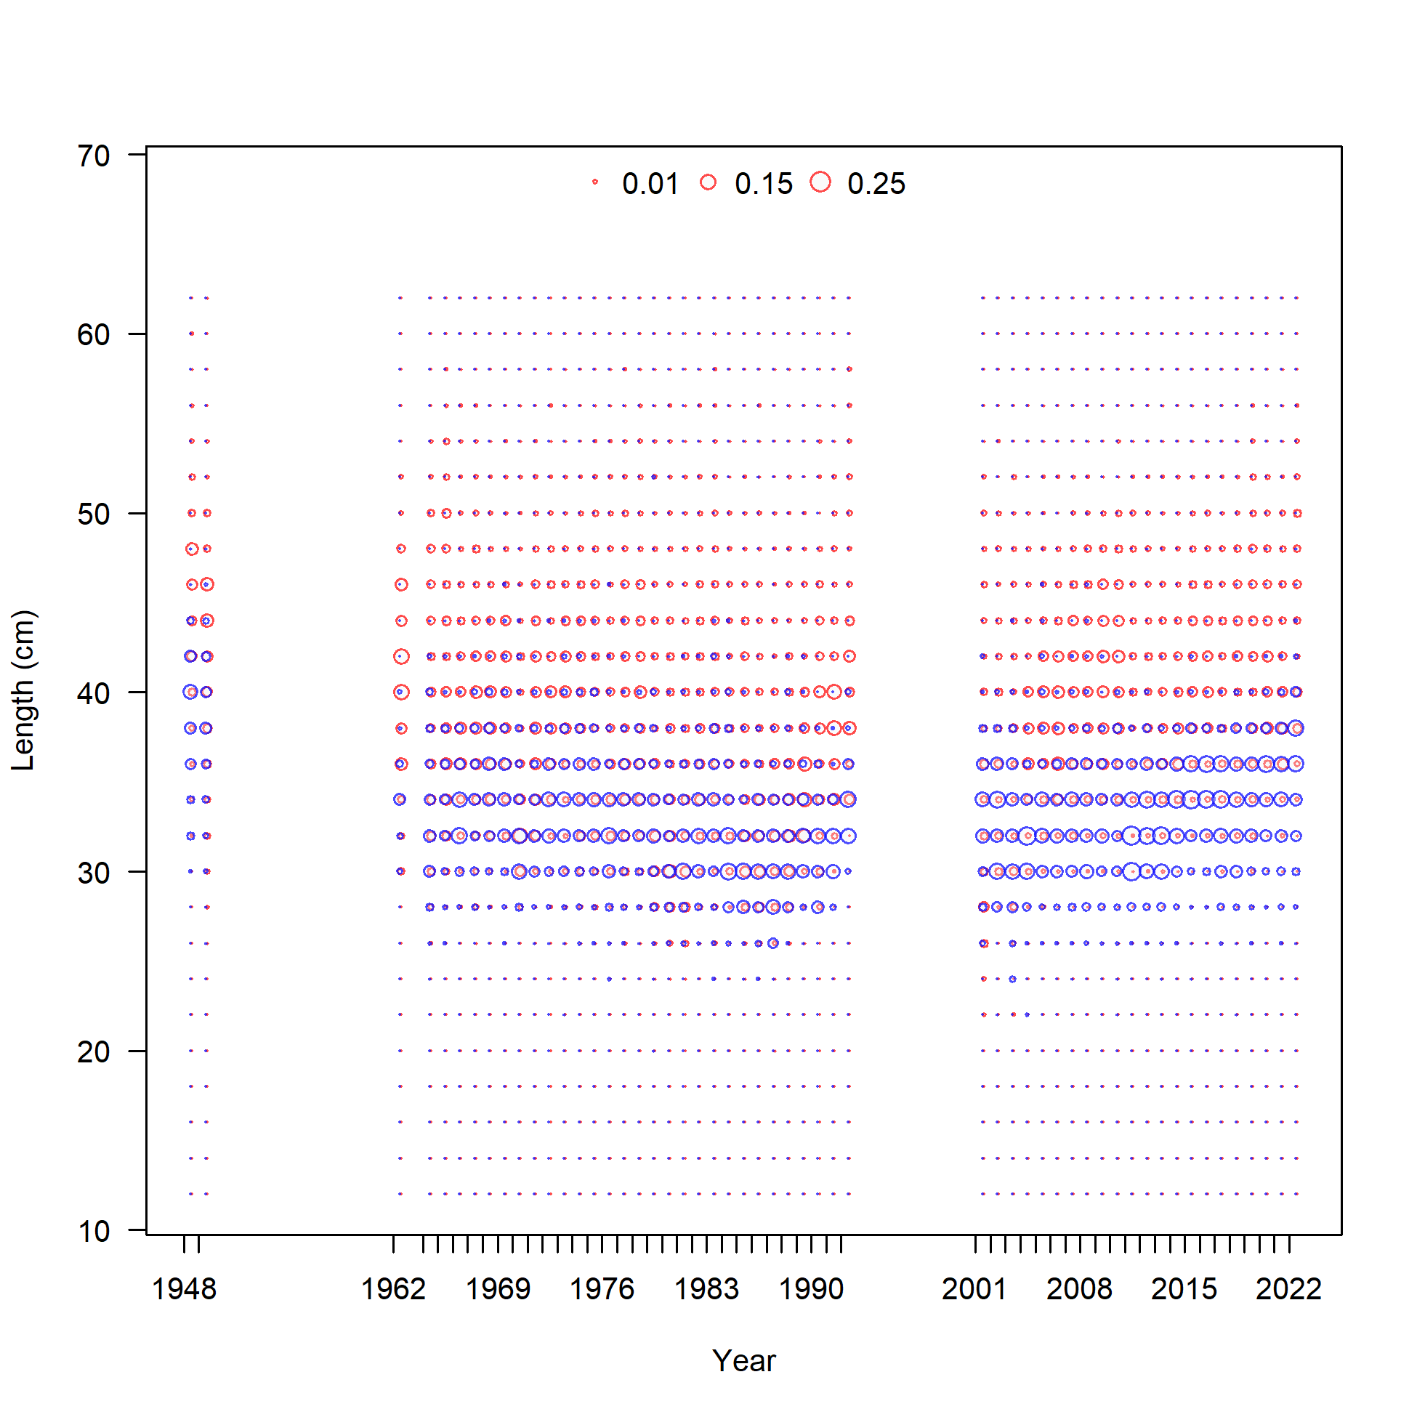
North fleet length compositions
South fleet length compositions
Blocks retained from 2019 model, new blocks added

Slide 35
Fit to indices
Poor fit to 2004 Triennial index is typical of other flatfish assessments
Fit to WCGBTS is among the best fit to this index across all west coast groundfish stocks.

Slide 36
Fit to length comps
Fit aggregated across years is very good
Slight mismatch in mode for South discards (which has the smallest sample sizes)

Slide 37
Fit to age comps
Reasonably good fit for North fleet, less good for South
South has limited ages, older than expected fish in recent years

Slide 38
Fit to discards
Catch limits were small in 2010 leading to higher discards. From 2011
onward the fishery was managed under Individual Fishing Quotas
Blocks on retention used to account for large changes

Slide 39
Diagnostics

Slide 40
Profile over log(R0)

Slide 41
Profile over stock-recruit steepness

Slide 42
Profile over natural mortality

Slide 43
Retrospective analysis

Slide 44
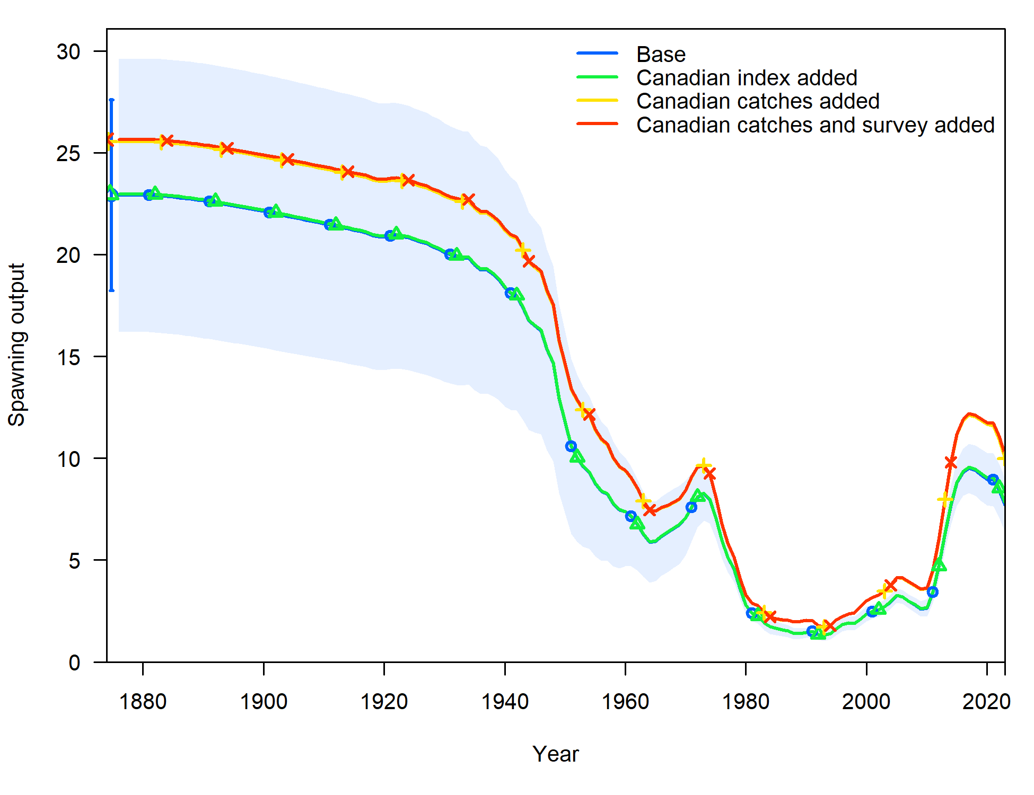
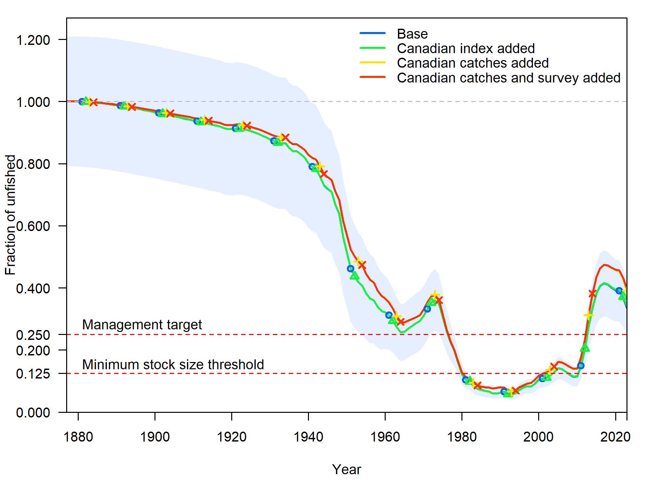
Sensitivity analysis – transboundary nature
Spawning biomass
Fraction unfished

Slide 45
Preliminary projections

Slide 46
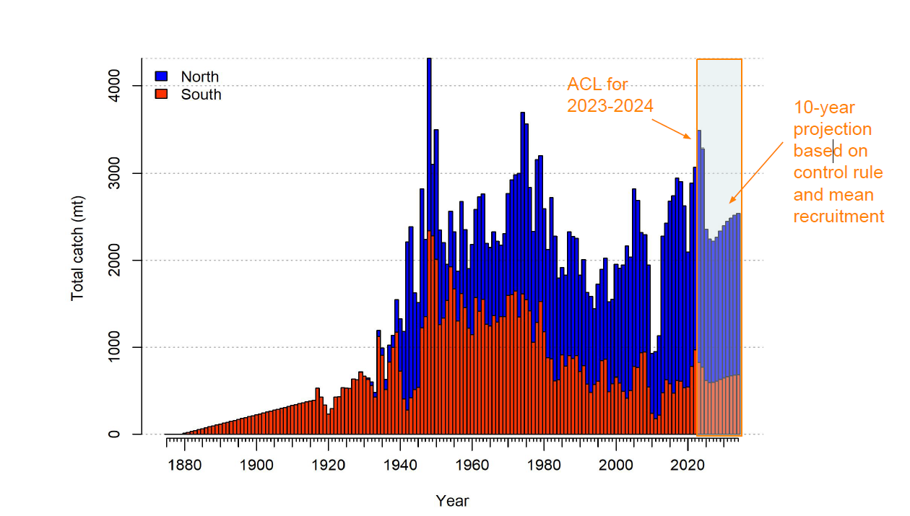
Preliminary projections

Slide 47
Preliminary projections
Forecast population expected to increase from 2027 onward due to
buffers in catch limits (and mean recruitment)

Slide 48
Concluding comments
• All data series have been extended with new data from 2019–2022 and historical data have been updated.
• The model has been simplified.
• Model estimates are substantially similar to previous assessments.
• Estimates of current fraction of unfished is 0.336, above the target reference point of 0.25 and an overfished threshold of 0.125.
• The biomass is estimated to be declining due to below-average recruitments in recent years.
• The data on petrale sole are informative.

Slide 49
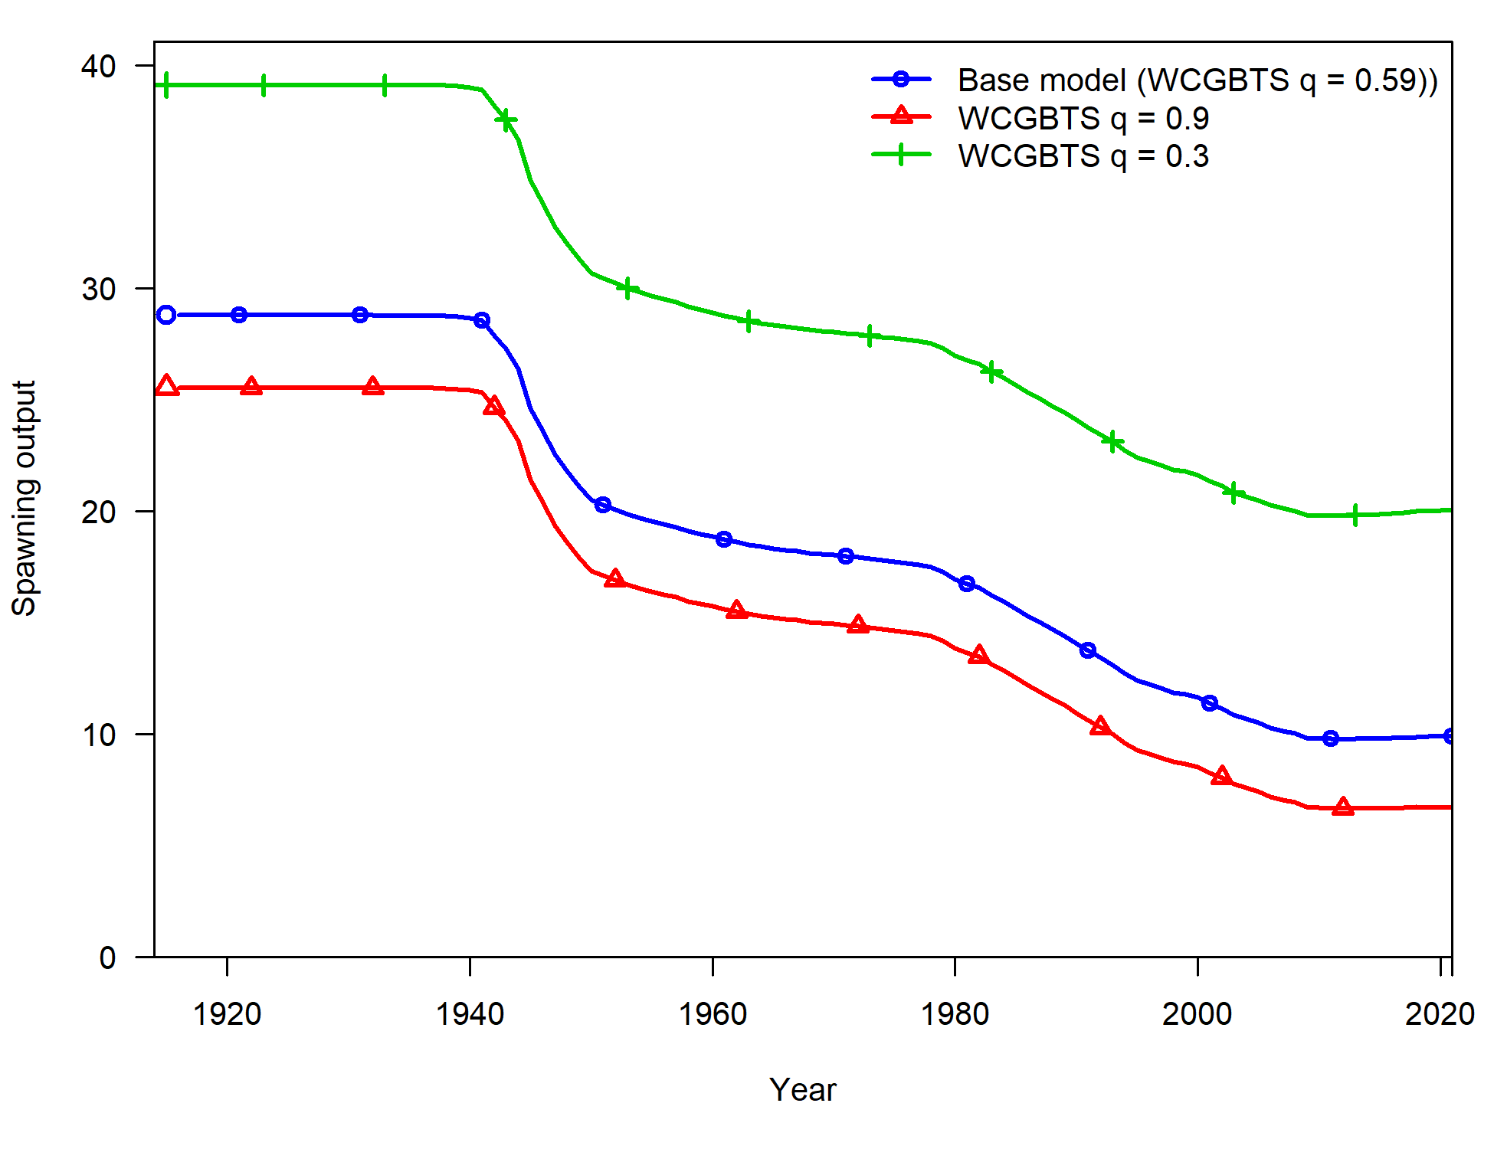
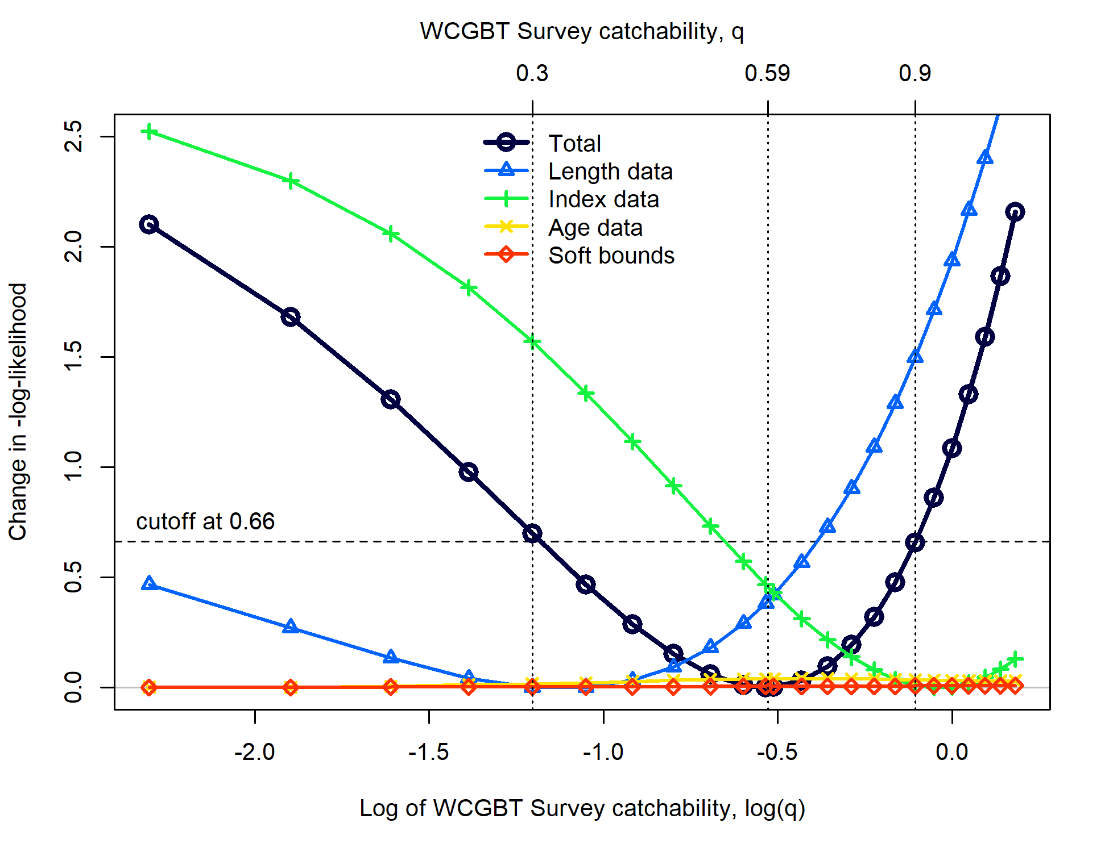
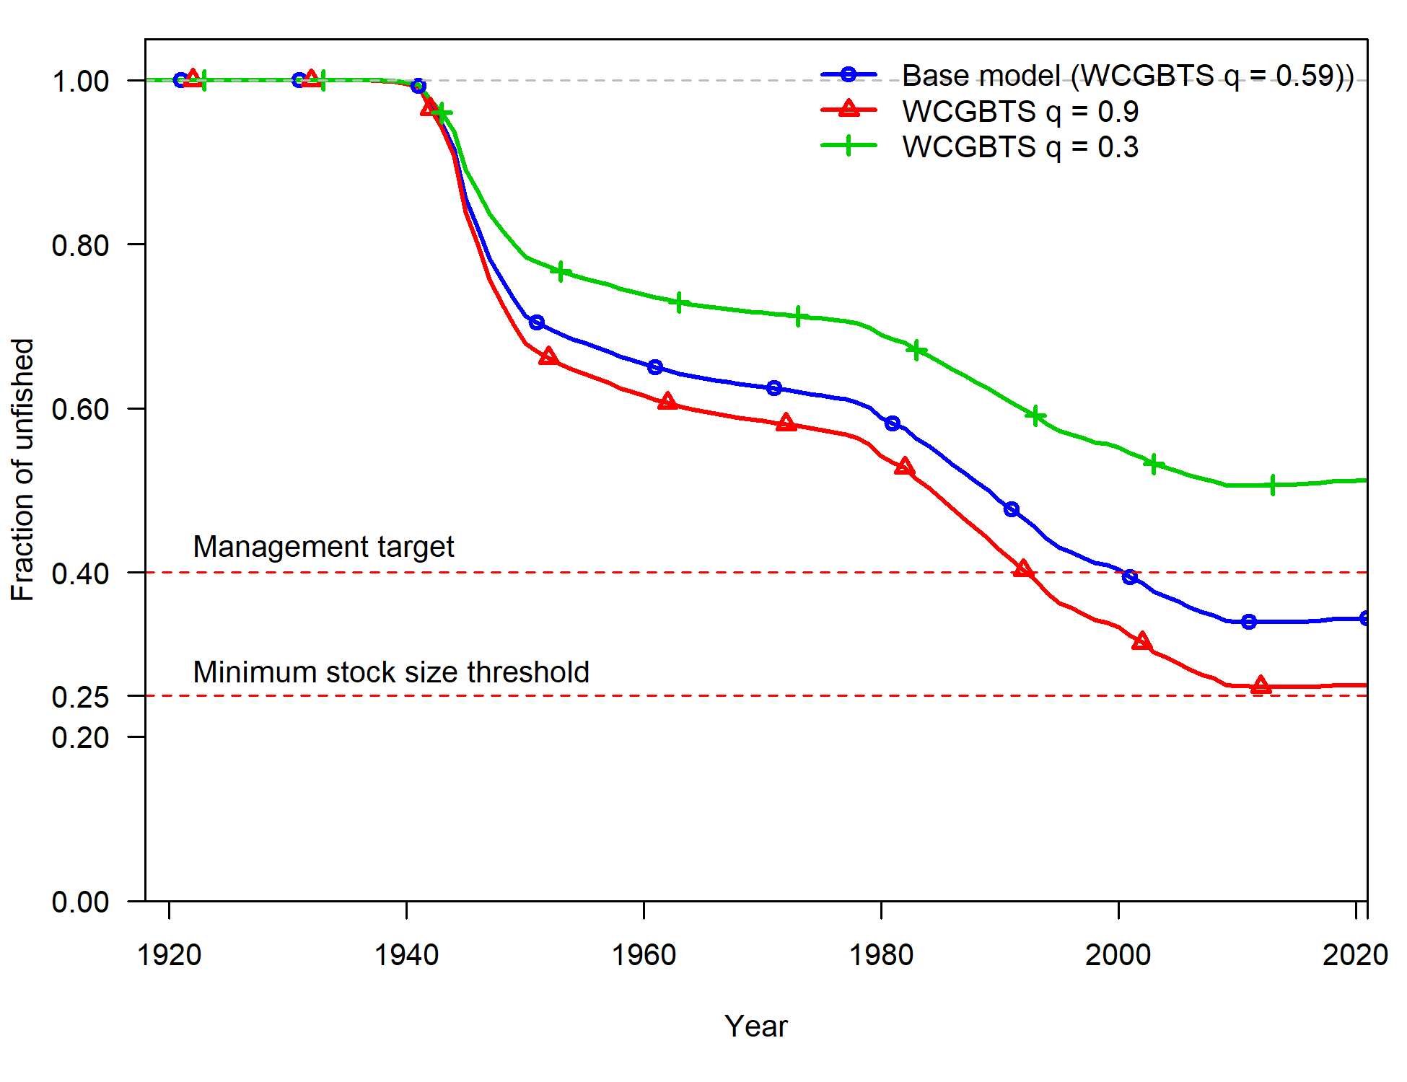
Axis of uncertainty and states of nature (spiny dogfish example)
WCGBTS q = 0.3 and 0.9 are close to 0.66 change in negative log-likelihood cutoff.
STAT proposes these two models as alternative states of nature with q as the axis of uncertainty.
Using profile to get states of nature captures the greater uncertainty at the upper end of the scale.

